Slide 1
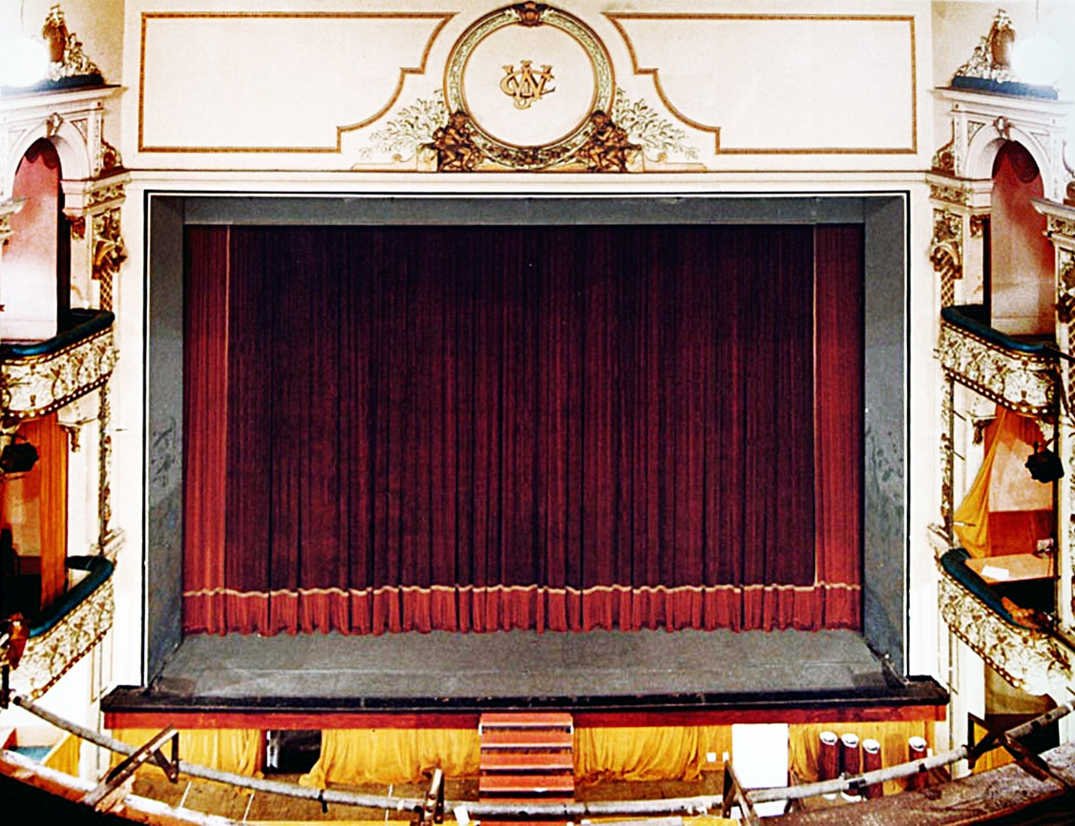
BREAK A LEG
A PERSONAL HISTORY OF
HIS MAJESTY’S THEATRE
IAN HANDRICKS

Slide 2
A number
of landmarks
in Auckland’s history
have been lost over time.
One of these is Queen Street’s
His Majesty’s Theatre & Arcade
(1902-1987)

Slide 3
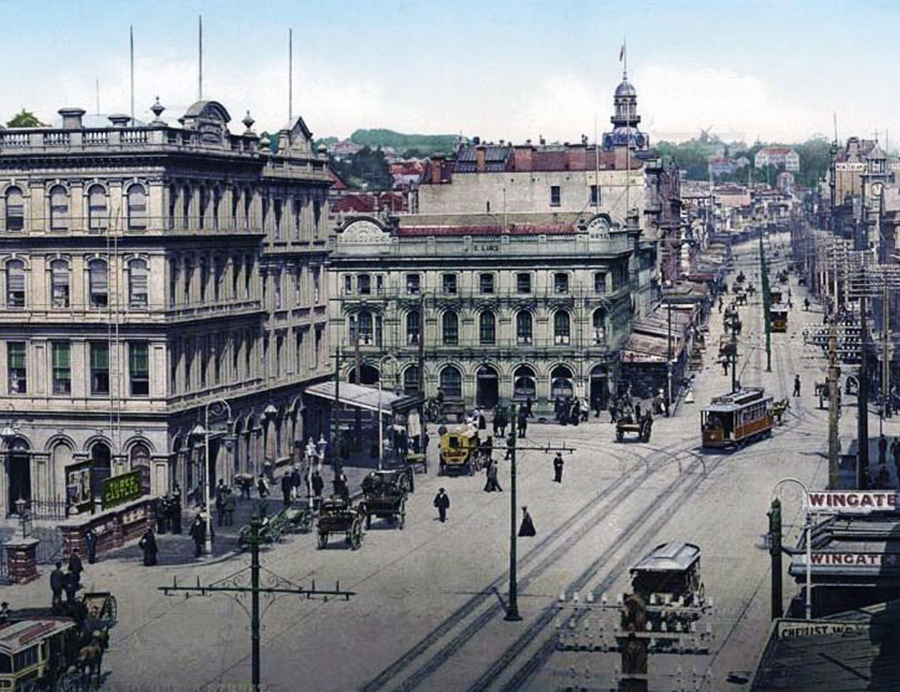
LOOKING UP QUEEN STREET, AUCKLAND 1902

Slide 4
The land on which the
arcade and theatre
were once situated
comprised part of
two of the original
Auckland land sale sections
from the 1840s

Slide 5
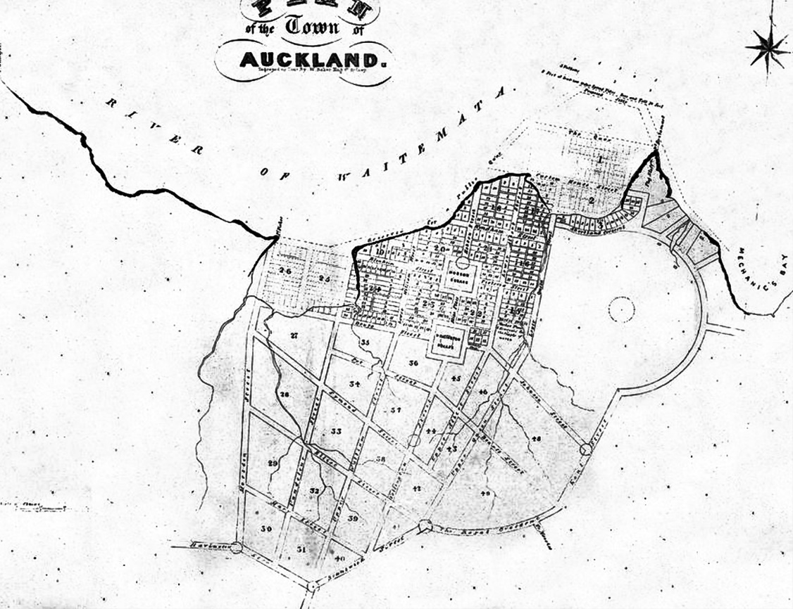
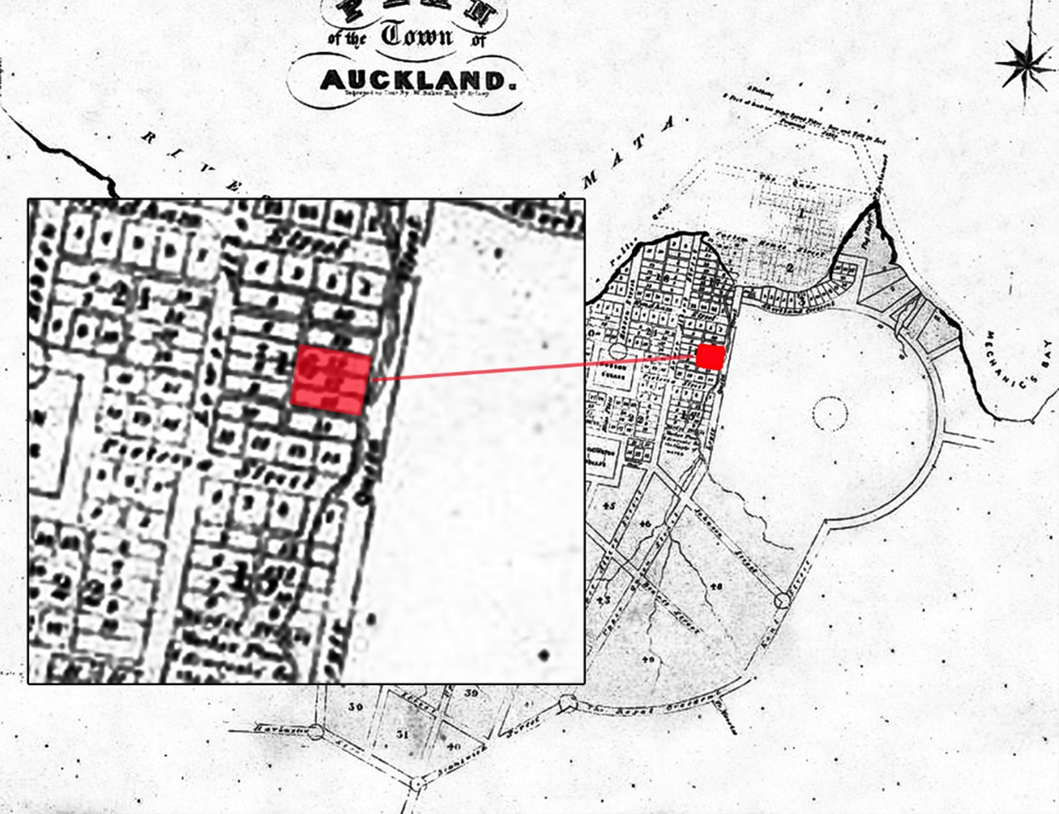

Slide 6
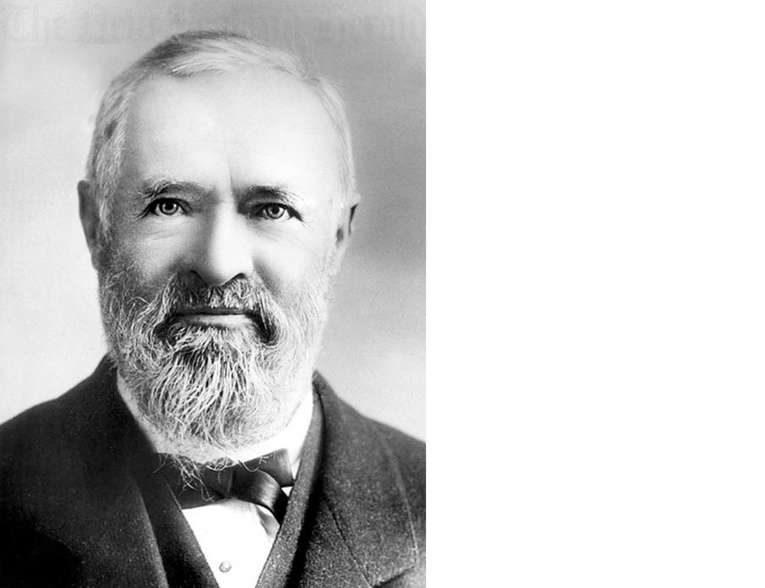
By 1860, Alfred Buckland, the renowned stock agent and auctioneer from Newmarket, had possession of a large part of future site of the theatre.
He set up first his Bazaar Sale Yards from August 1859 then from October 1860 he took the Queen Street to Durham Lane operation a bit more further – and renamed it the Haymarket, building offices at the Queen Street frontage.

Slide 7
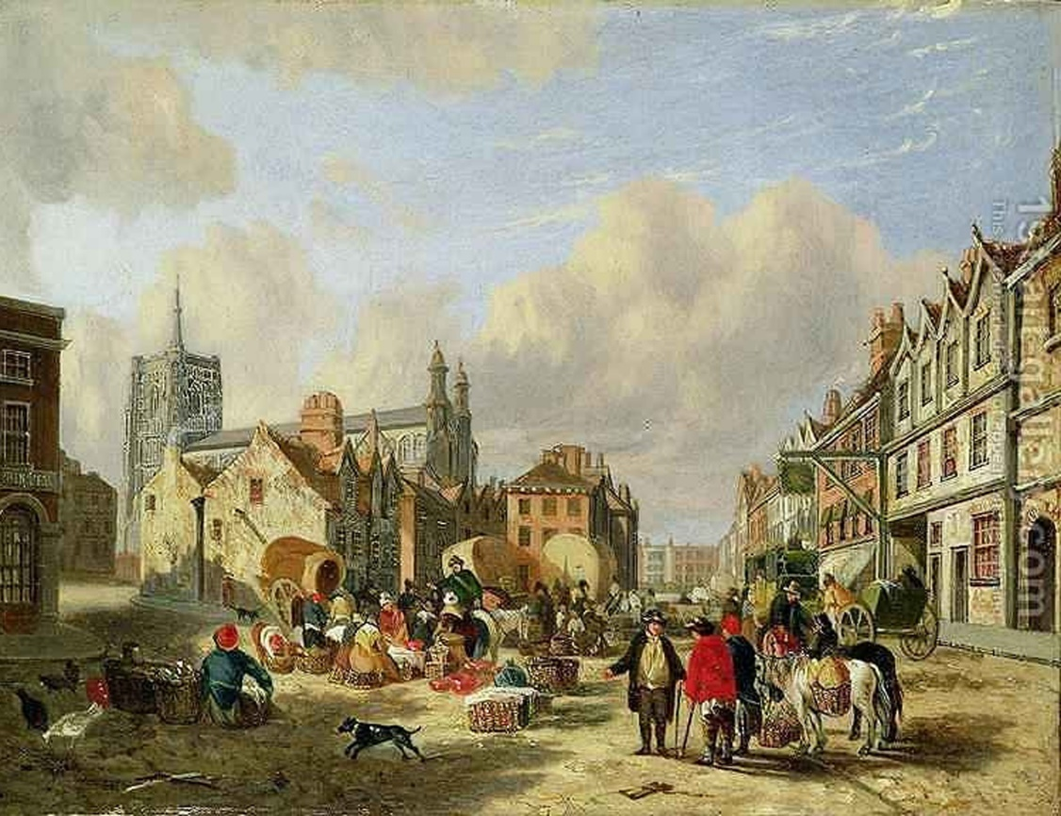
Buckland renamed the area “The Haymarket” and he built offices at the Queen Street frontage. The original Haymarket is in the west end of London and was used from Elizabethan times through to 1830 as a place for farmers to sell fodder (hence the name) and produce

Slide 8
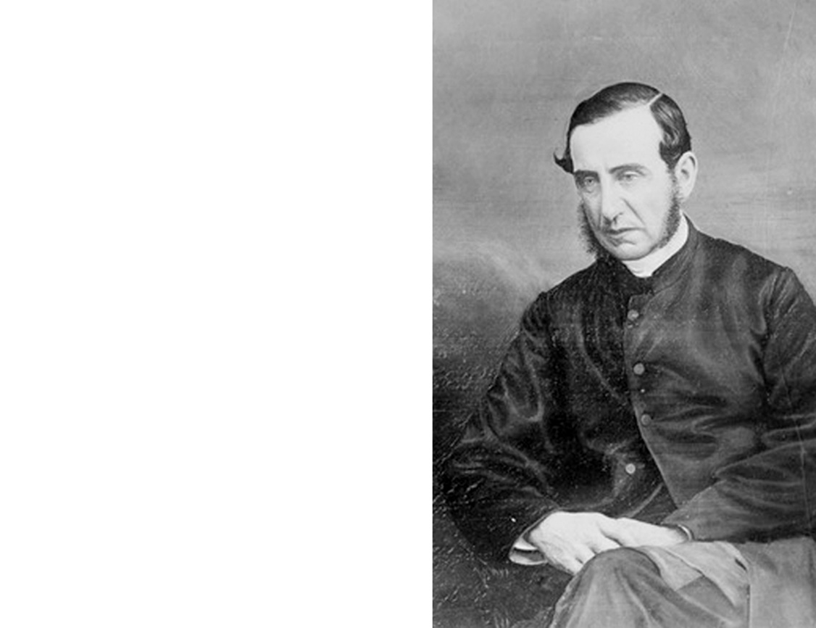
Buckland subdivided around 2/3 of the Queen Street frontage in the 1860s and transferred this to Bishop John Coleridge Patteson.
On Patteson’s death in 1871, killed on the island of Nukapu in the Solomon Islands, his estate went to the Melanesian Trust Board

Slide 9
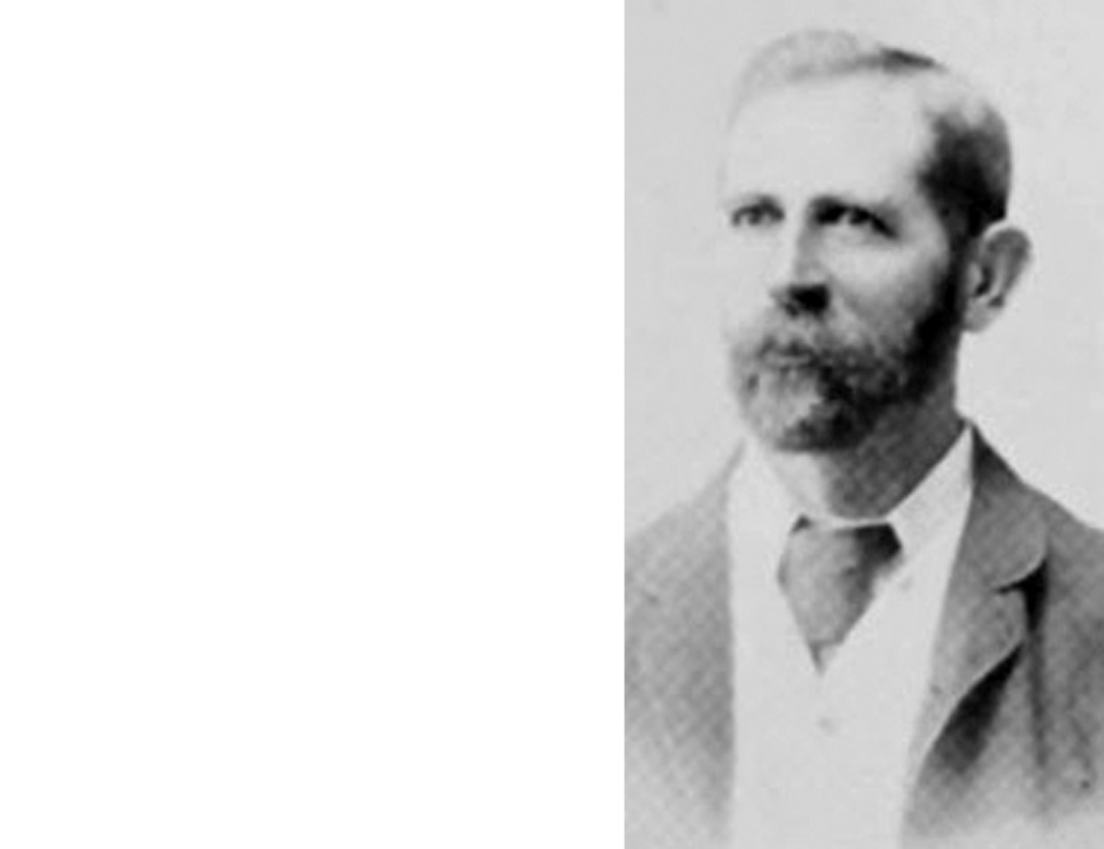
As with many other land holdings Buckland had in Auckland, mortgages caught up with him and in 1887 his Haymarket passed to the ownership of the Bank of New Zealand, and their Assets Realisation Board ten years later.
They leased the property back to Buckland, his son, and his son-in-law Henry Thomson Gorrie, and the Haymarket continued for a time.

Slide 10
The fact that
His Majesty’s Theatre existed at all really is due to two men...
Robert Henry Abbott &
Percy Reginald Dix

Slide 11
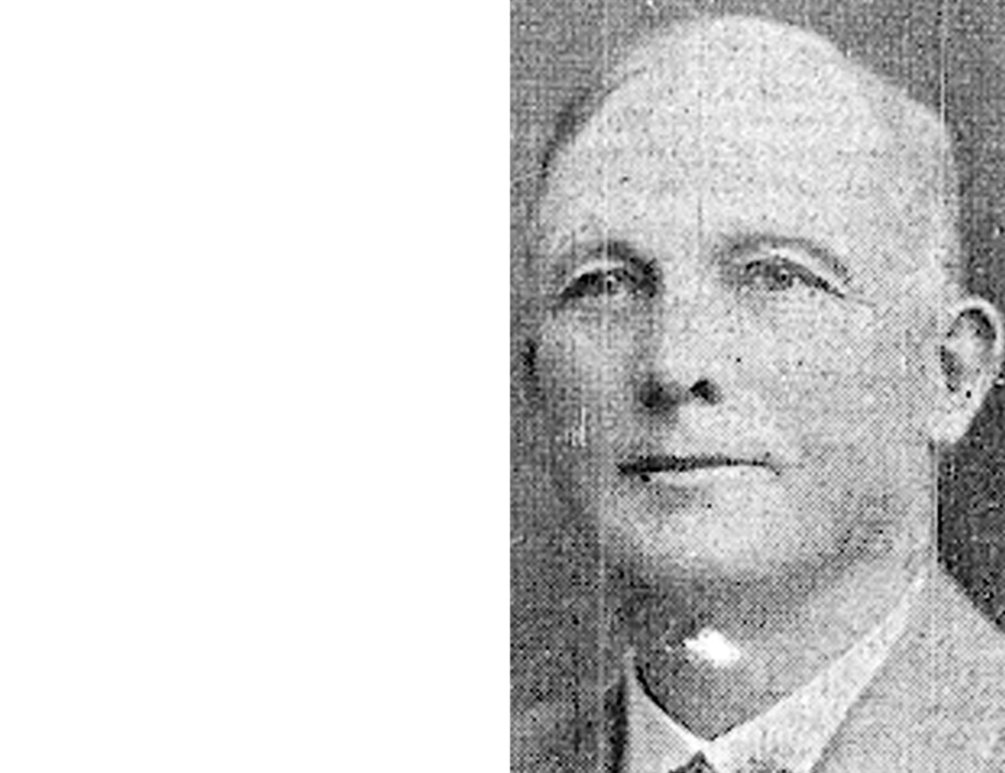
Robert Henry Abbott
(1861-1927)
born in North Molten, Devonshire, and the founder of the warehouseman and wholesale merchants firm of Abbott, Oram and Co (later becoming R H Abbott & Co.

Slide 12
Robert Henry Abbott retired from business in 1911, erected blocks of retail premises around the city, and served on boards of directors, including as Chairman of the Waiatarua Drainage Board, purchasing 100 acres of the reclaimed area around Mt St John and presenting it to Auckland City as a sports park.
He bequeathed £1000 to the City for either a set of entry gates to the park, or a drinking fountain there. Abbotts Way, from Ladies Mile to Panmure, was named after him.

Slide 13
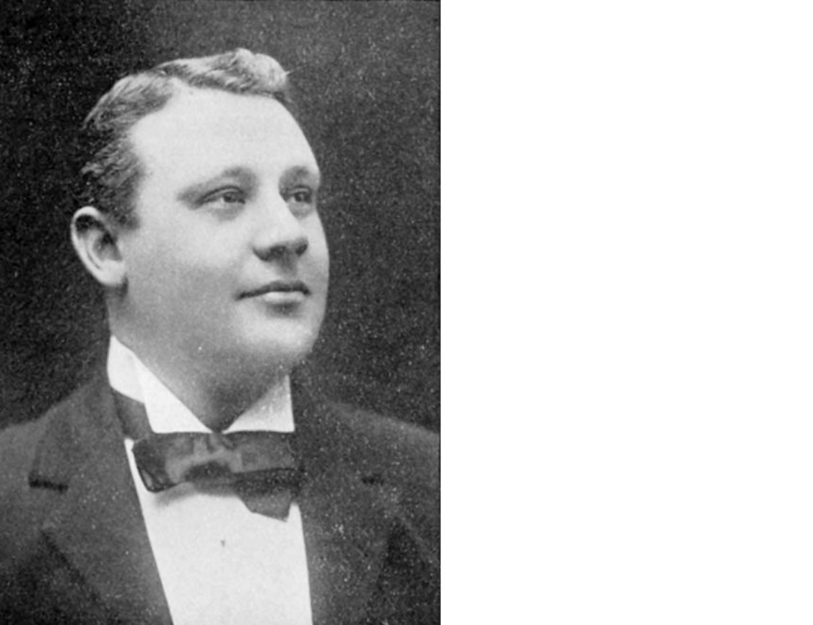
Percy Reginald Dix
(1866-1917).
born in Launceston, Tasmania, he shifted to Auckland in 1891, setting up his tea merchandising business. In 1895, Dix began leasing the City Hall theatre, staging popular concerts. When Fullers brought in bijoux vaudeville (at the Agricultural Hall, then City Hall), Dix followed suit in 1899 with his “Dix’s Gaiety Company”.

Slide 14
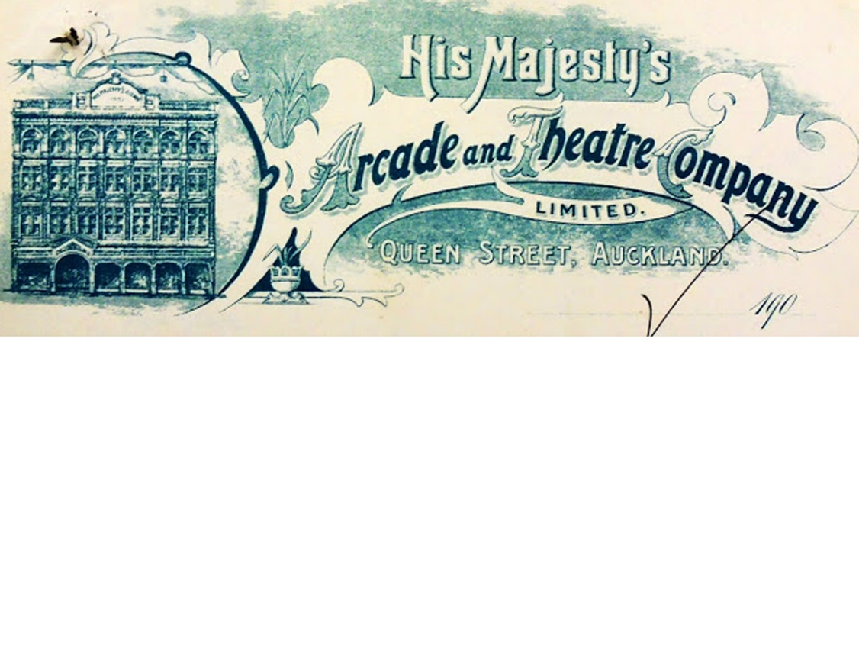
Buckland’s Haymarket site was formally sold to Abbott in June 1902 (who immediately put the property in the name of the His Majesty’s Arcade and Theatre Company Ltd, of which he was chairman) and a 50-year lease was taken out with the Melanesian Mission Trust Board for their land just in front of the theatre site, to form the bulk of the arcade, from 1 April 1902.

Slide 15
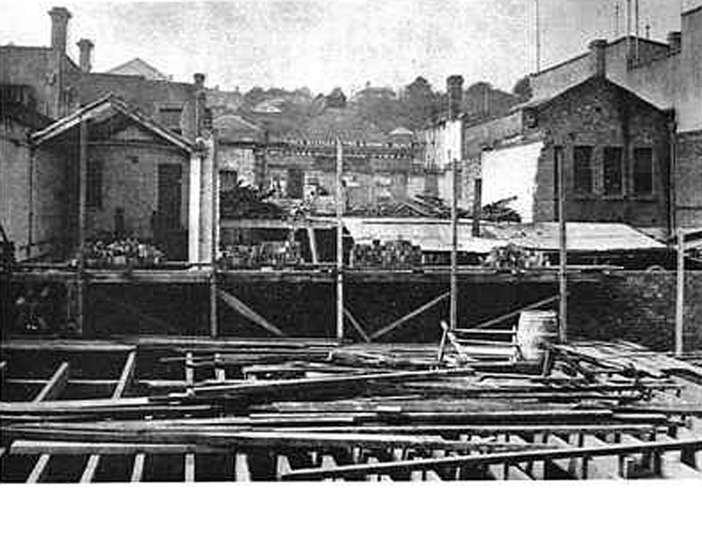
In 1901, construction began on the new His Majesty’s Theatre

Slide 16
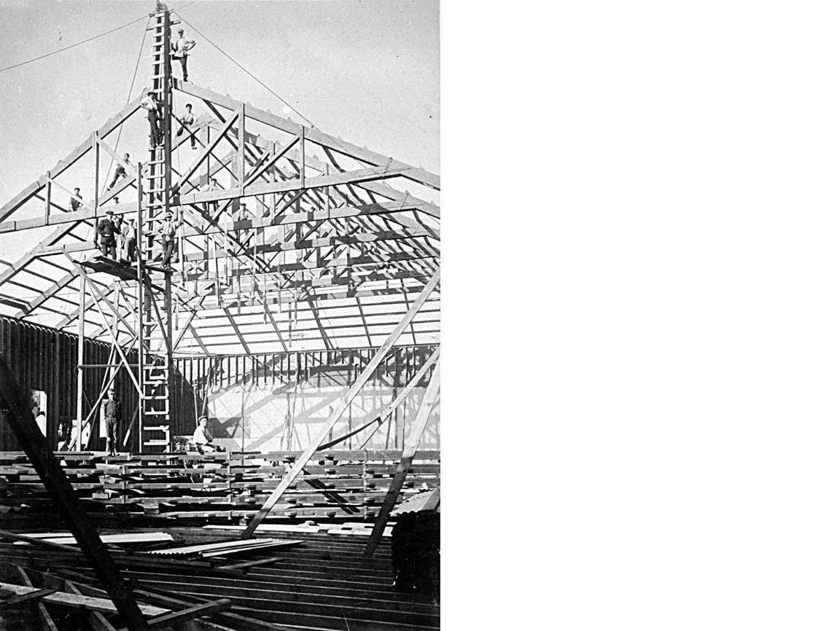
His Majesty’s was designed to seat 1700 people in stalls, dress circle and family circle (known as the “Gods”), it had 6 private boxes, a 50ft x 60ft stage, a patented sliding roof and 6 separate entrances.

Slide 17
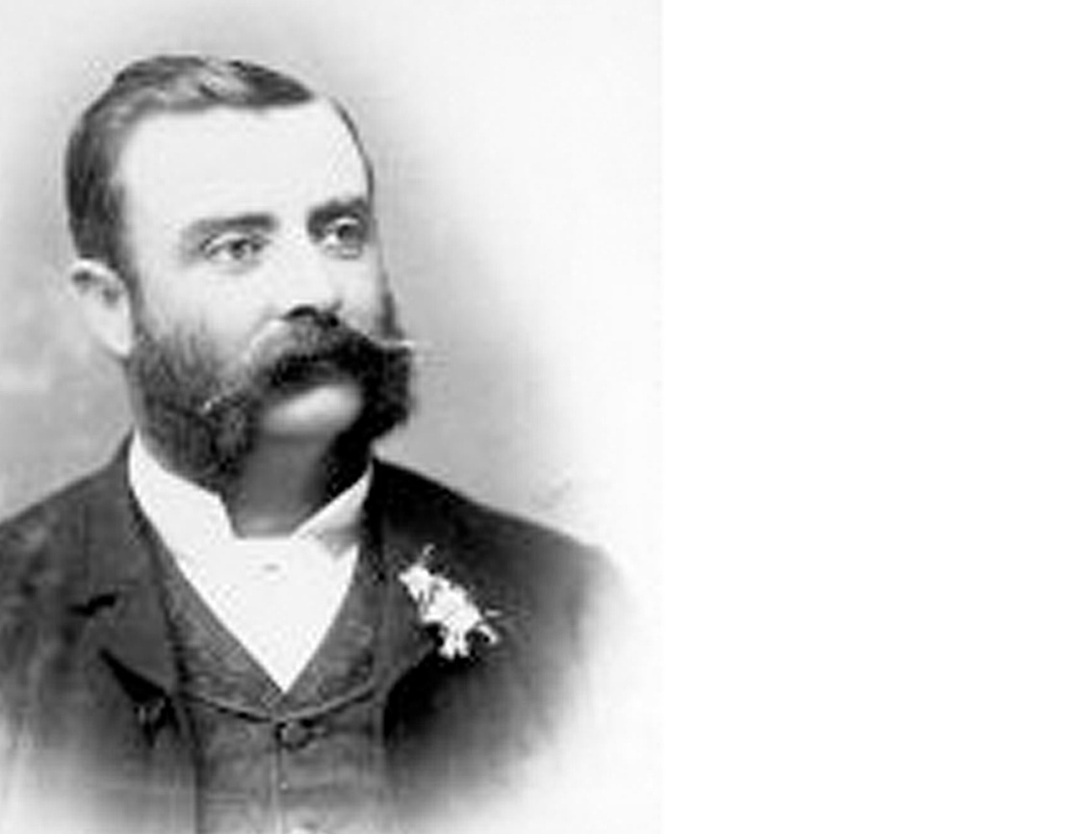
His majesty’s was designed by the well-known Australian architect and politician,
William Pitt

Slide 18
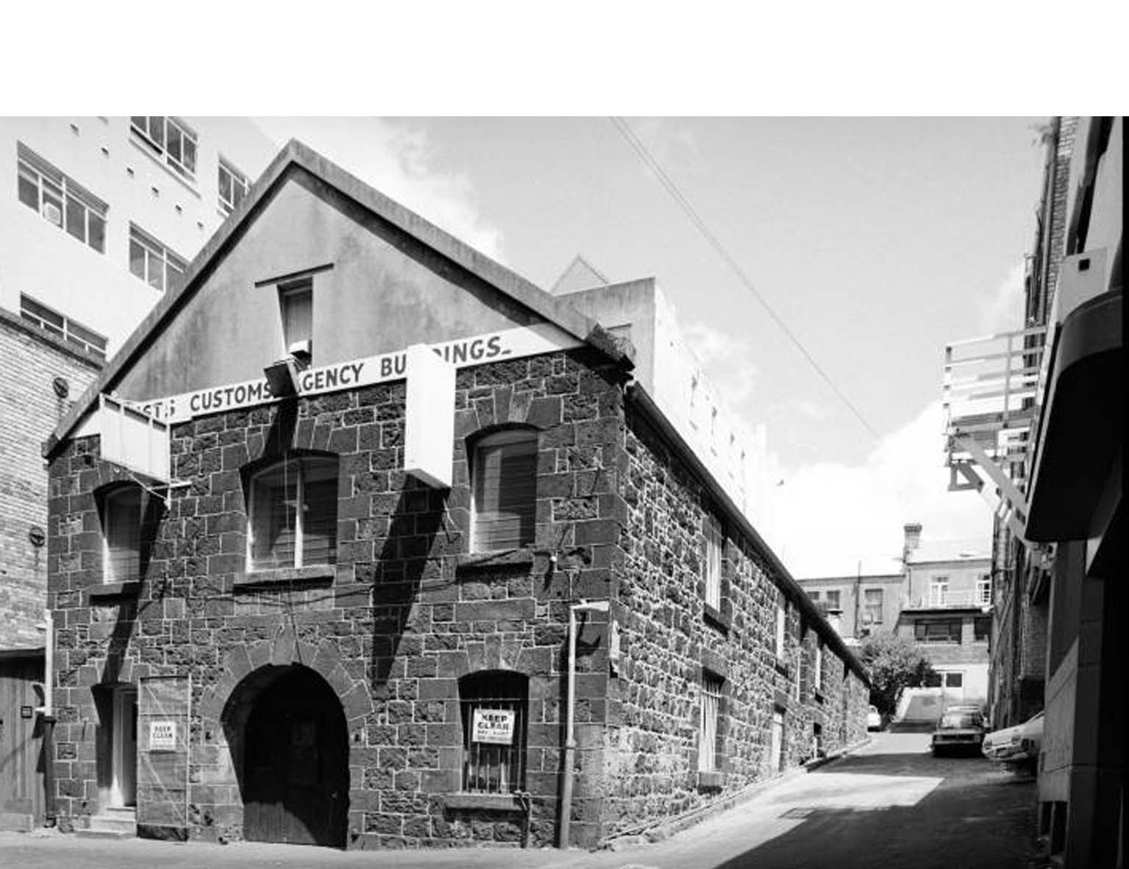
The new theatre sat in front of
The Blue Stone Customs Agency Building

Slide 19
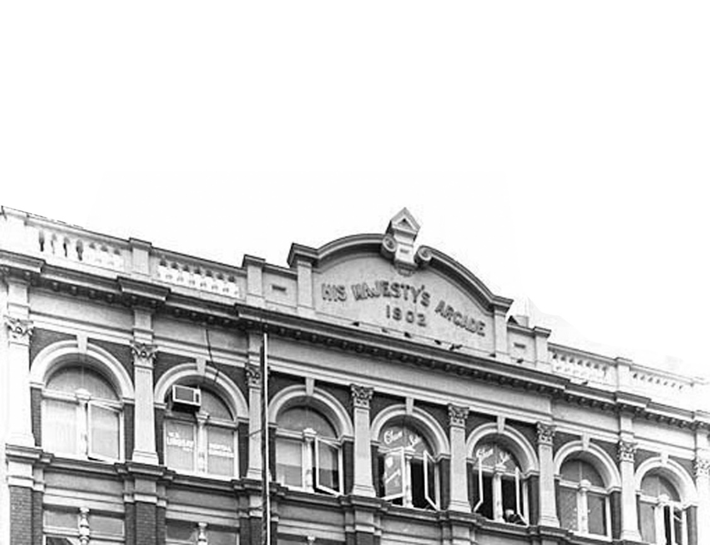
On completion, His Majesty’s was leased for 10 years by Percy Reginald Dix

Slide 20
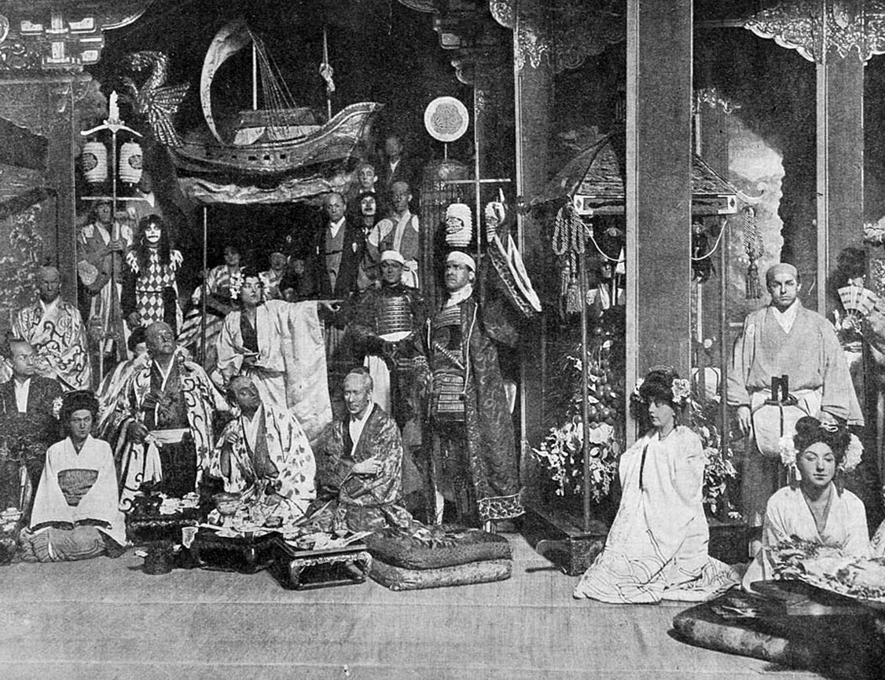
The first performance was by J S Williamson’s Musical Comedy Company of “A Runaway Girl” on 26 Dec 1902

Slide 21
Around the same time
my grandfather
Norrie Handricks
was a well-known and
respected theatrical
agent, theatre owner and
entrepreneur

Slide 23
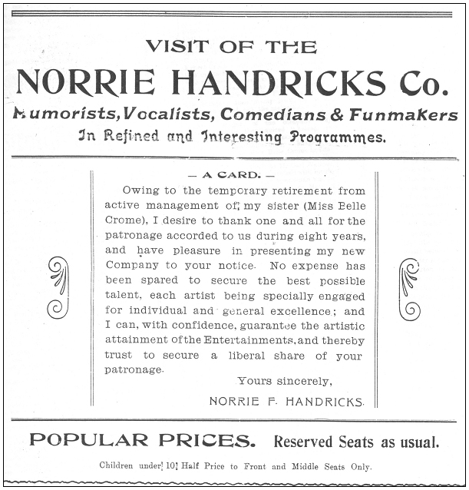
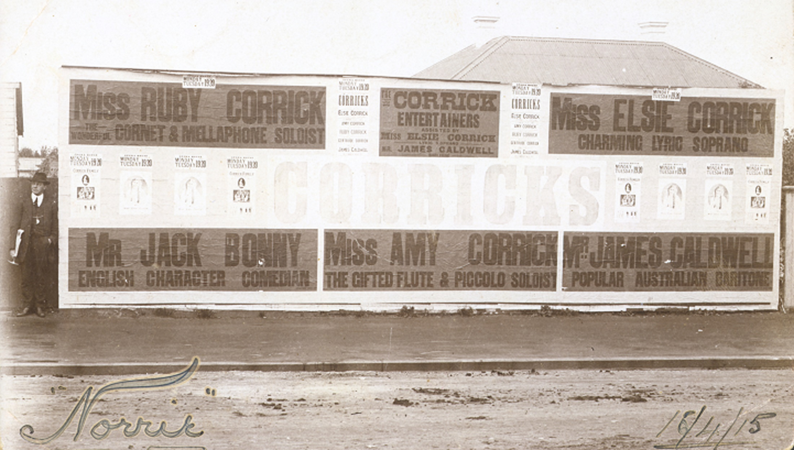
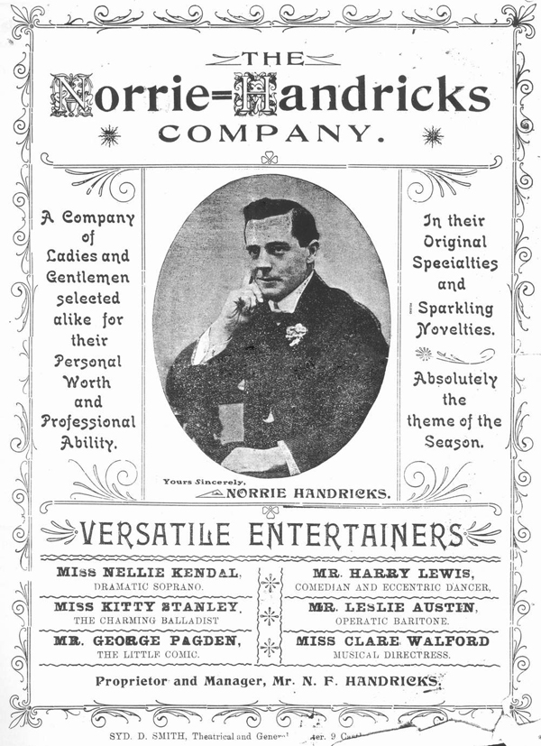

Slide 24
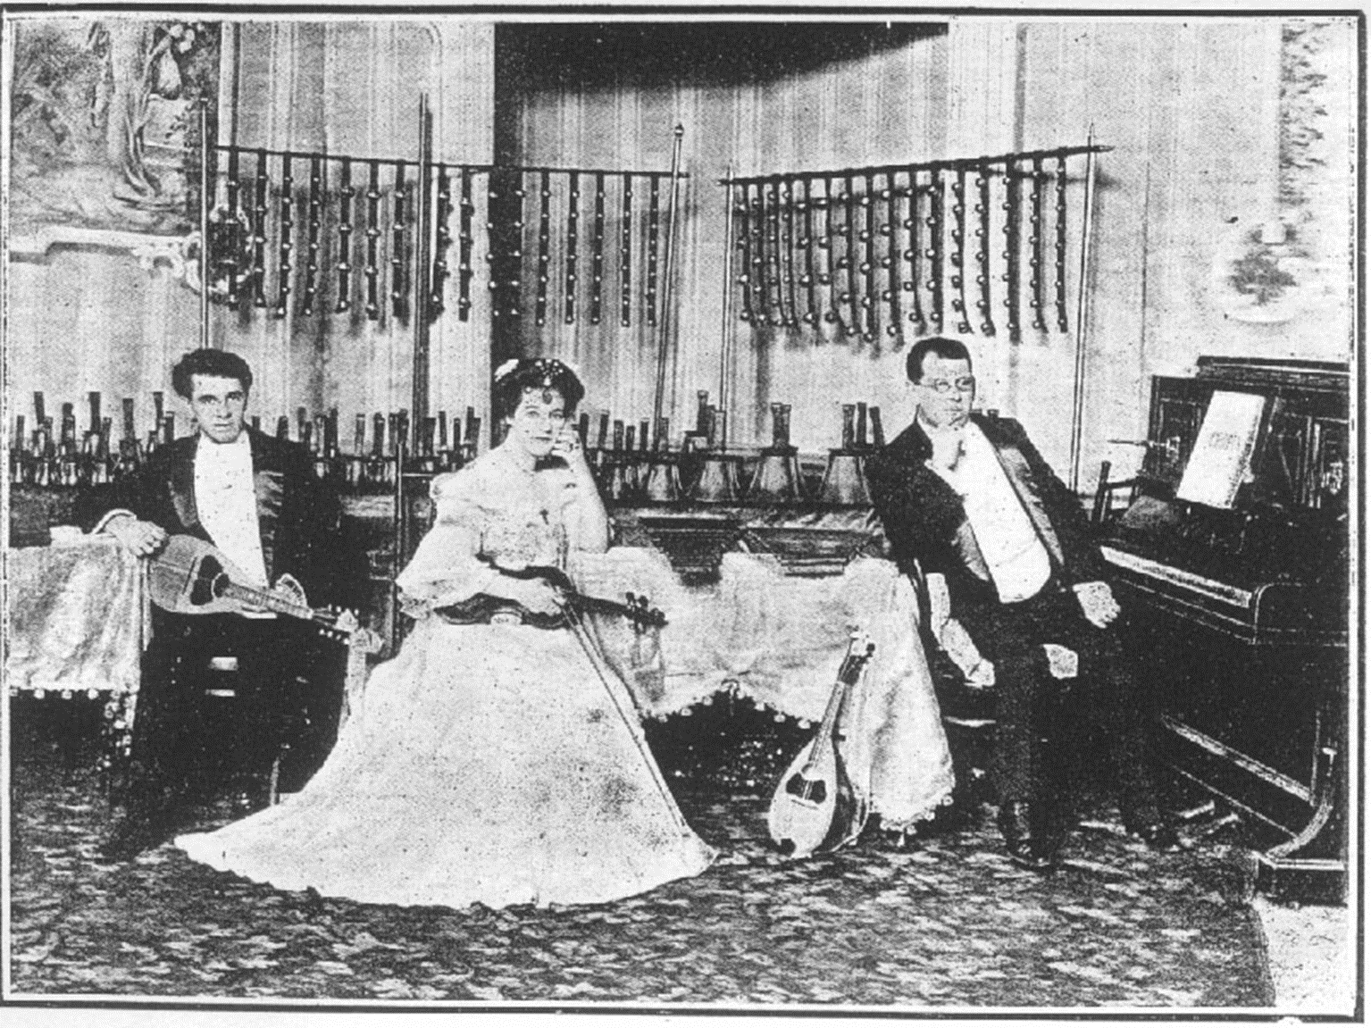

Slide 25
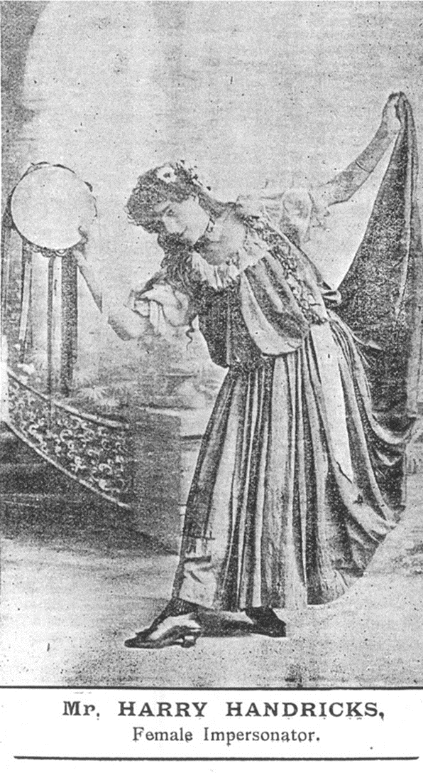
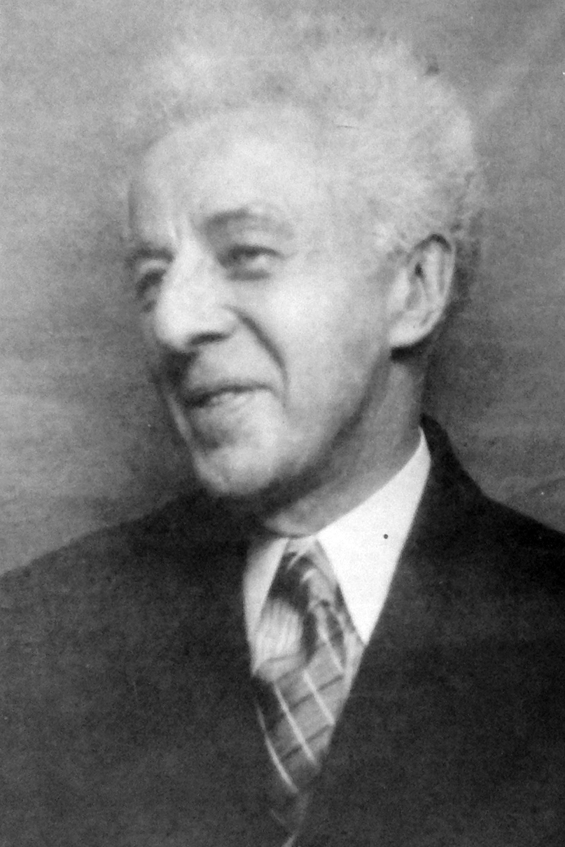

Slide 26
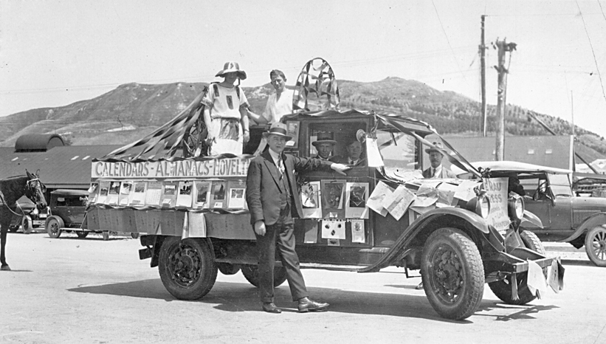
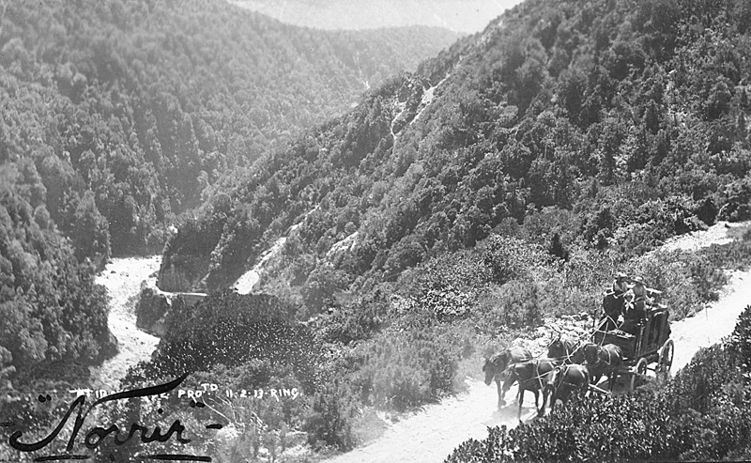
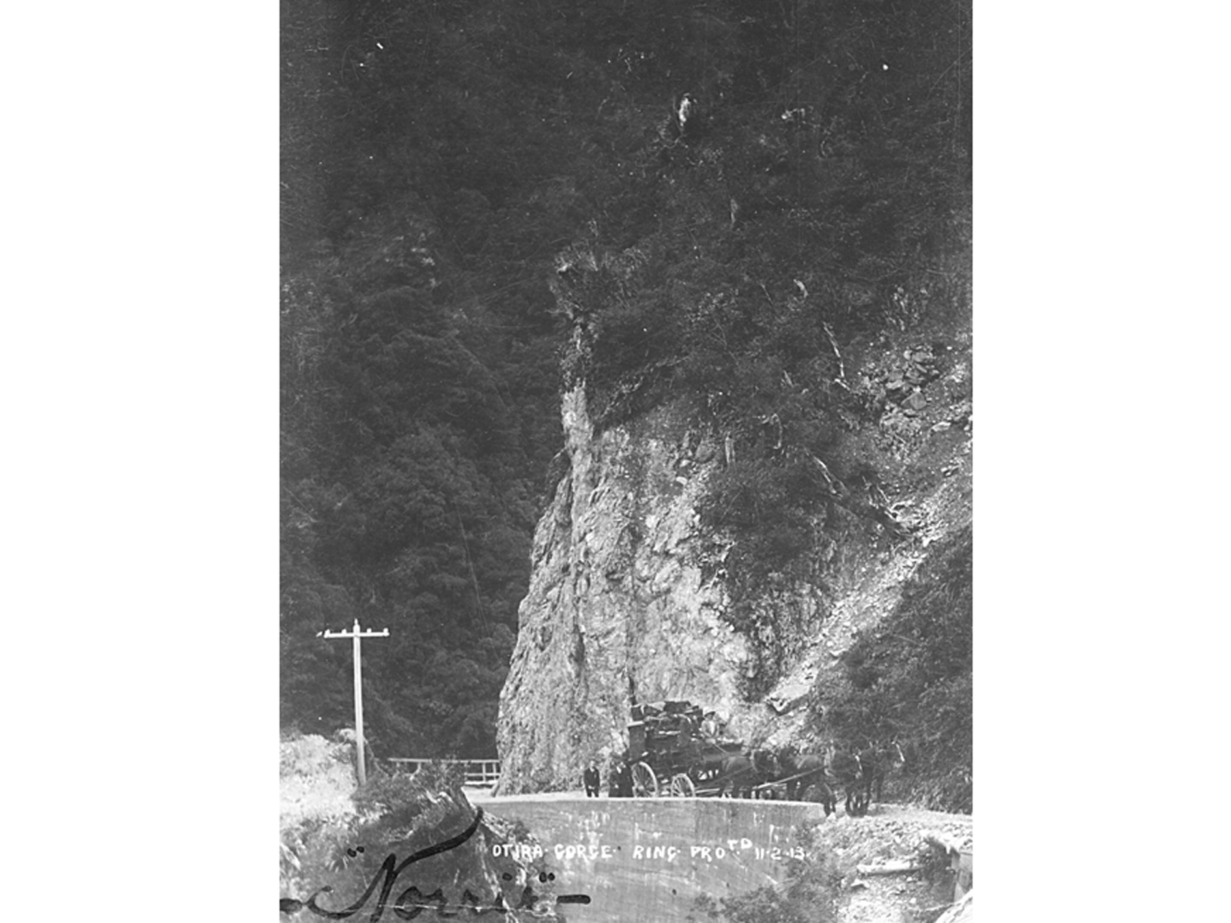
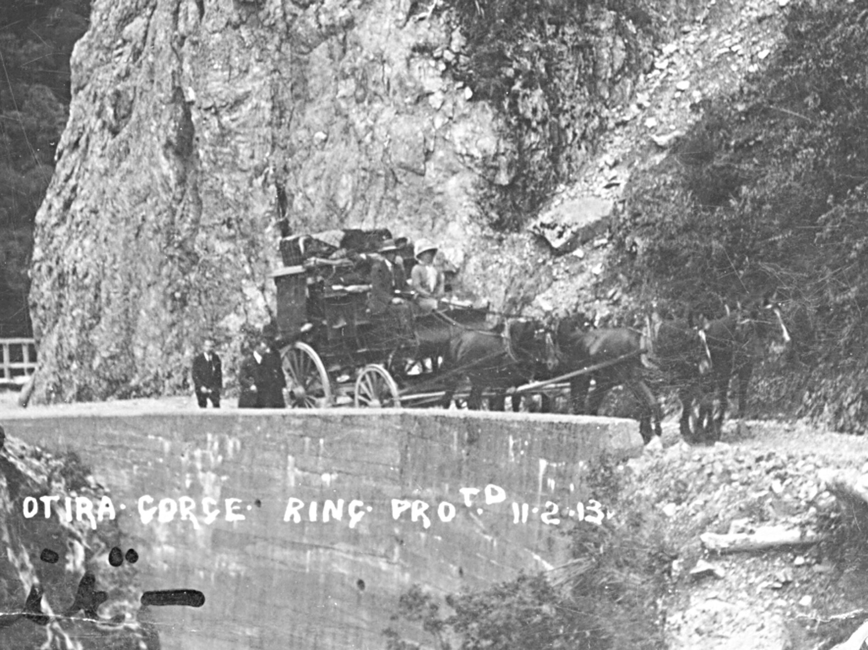
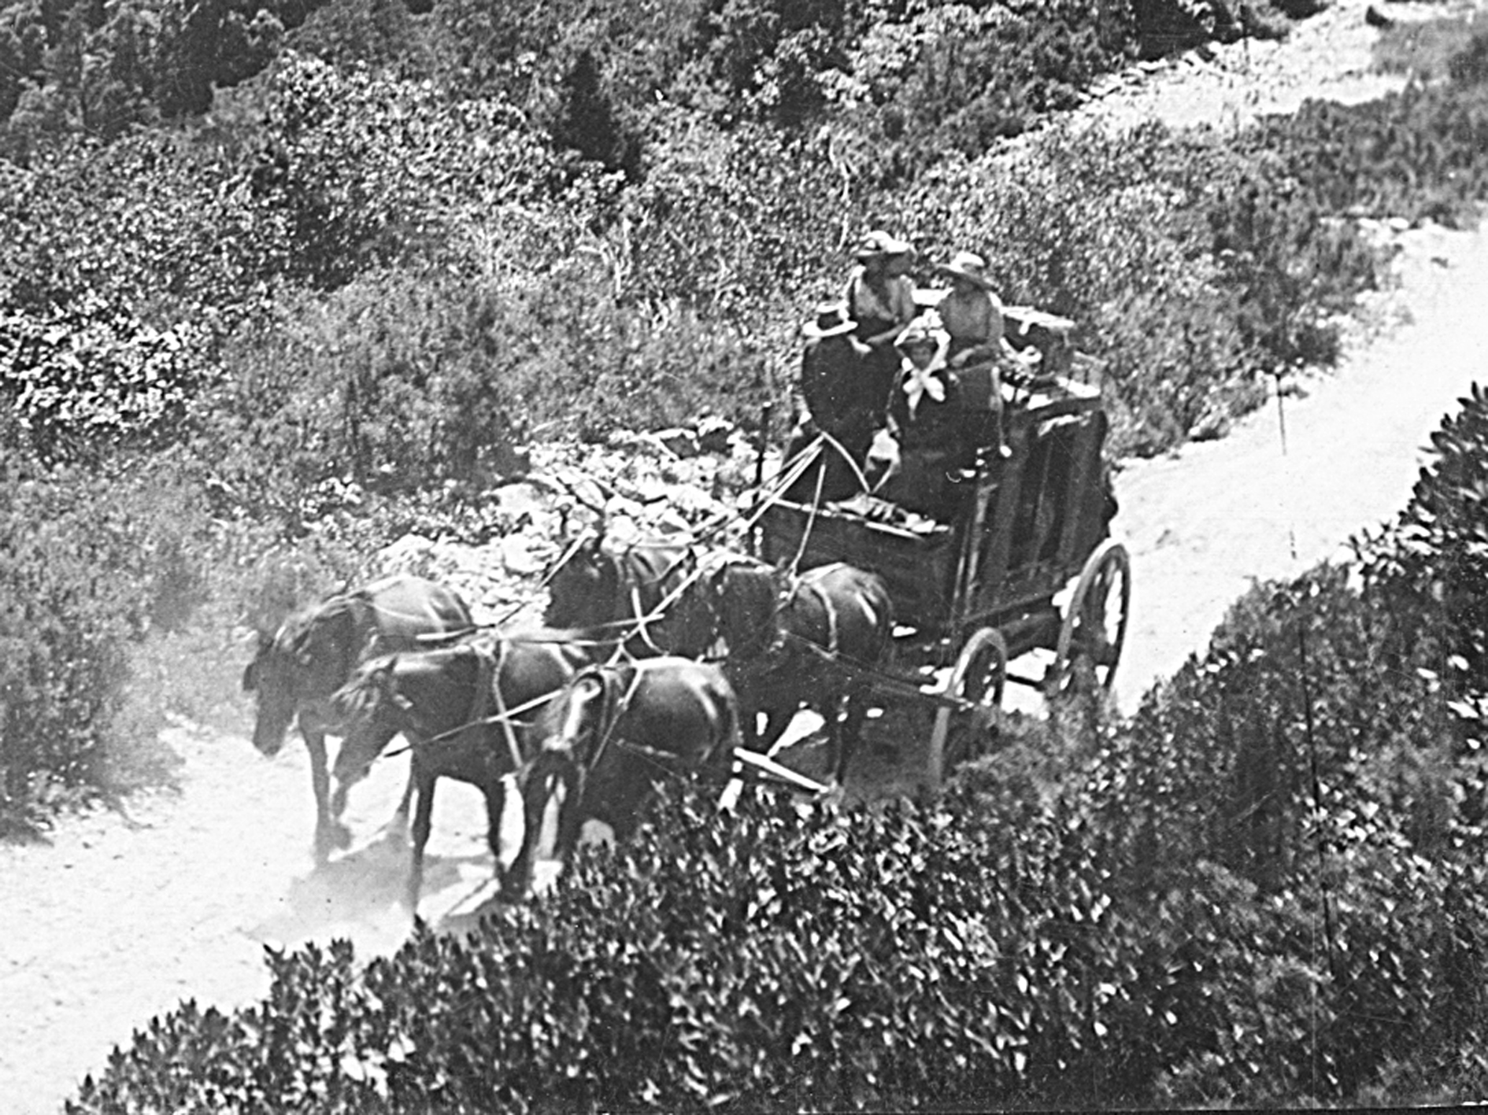

Slide 27
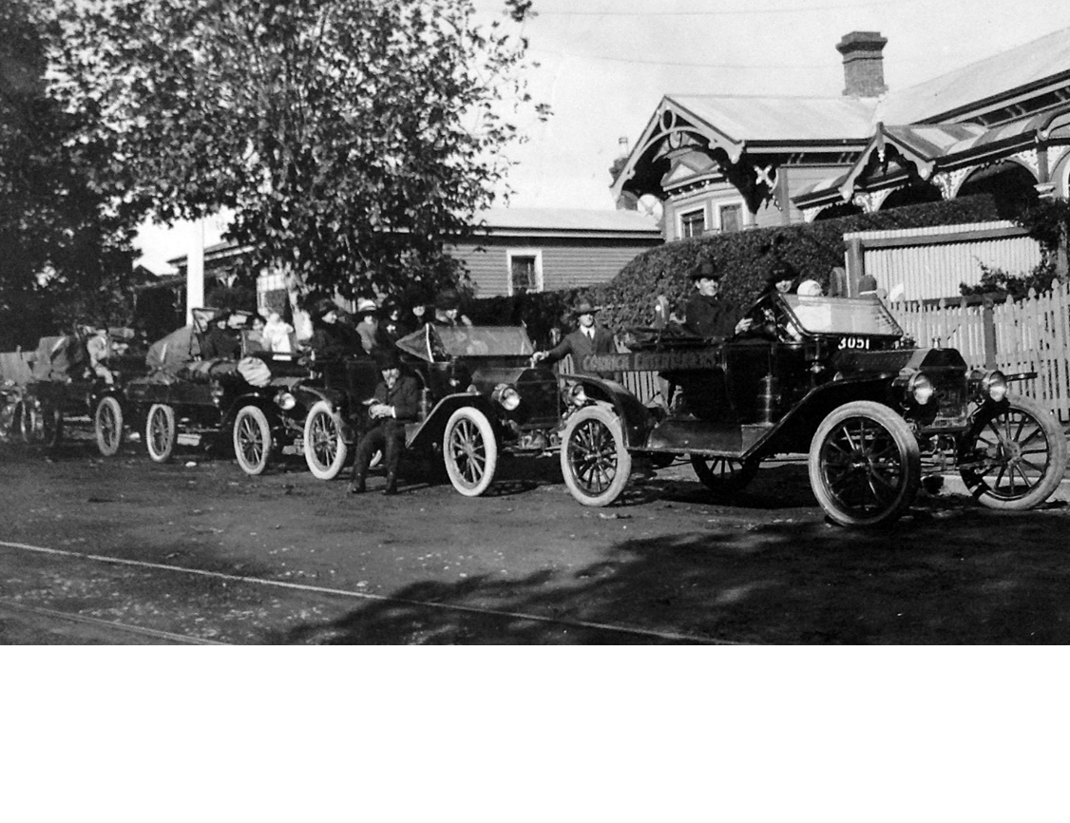
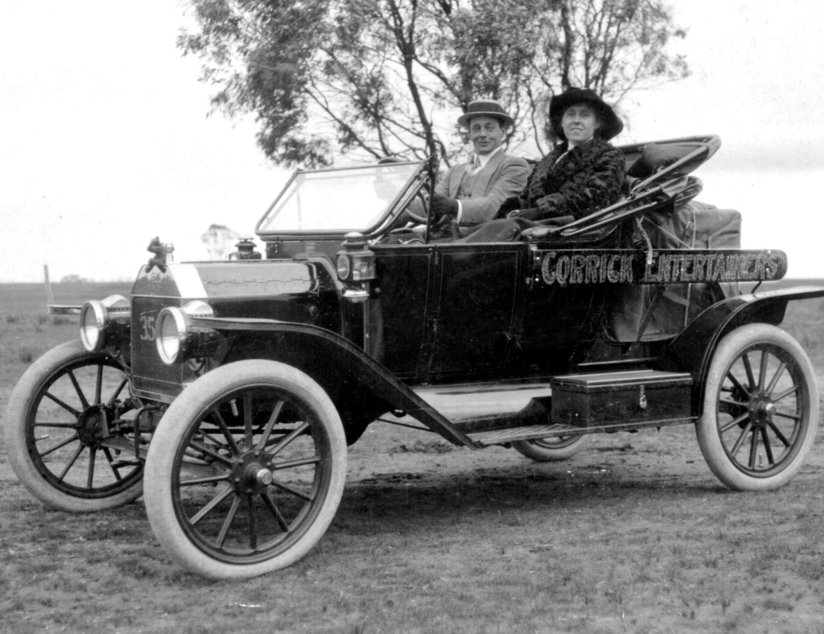
… in later years he toured his entertainers by car

Slide 28
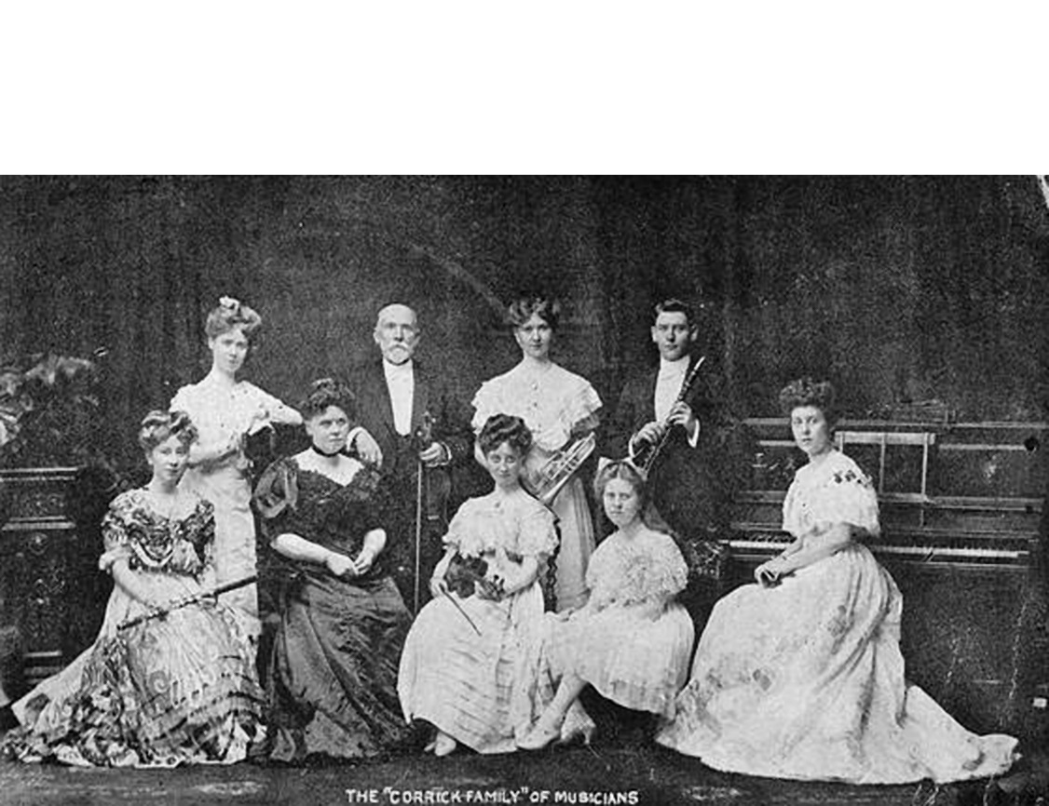
He managed and promoted many famous acts

Slide 29
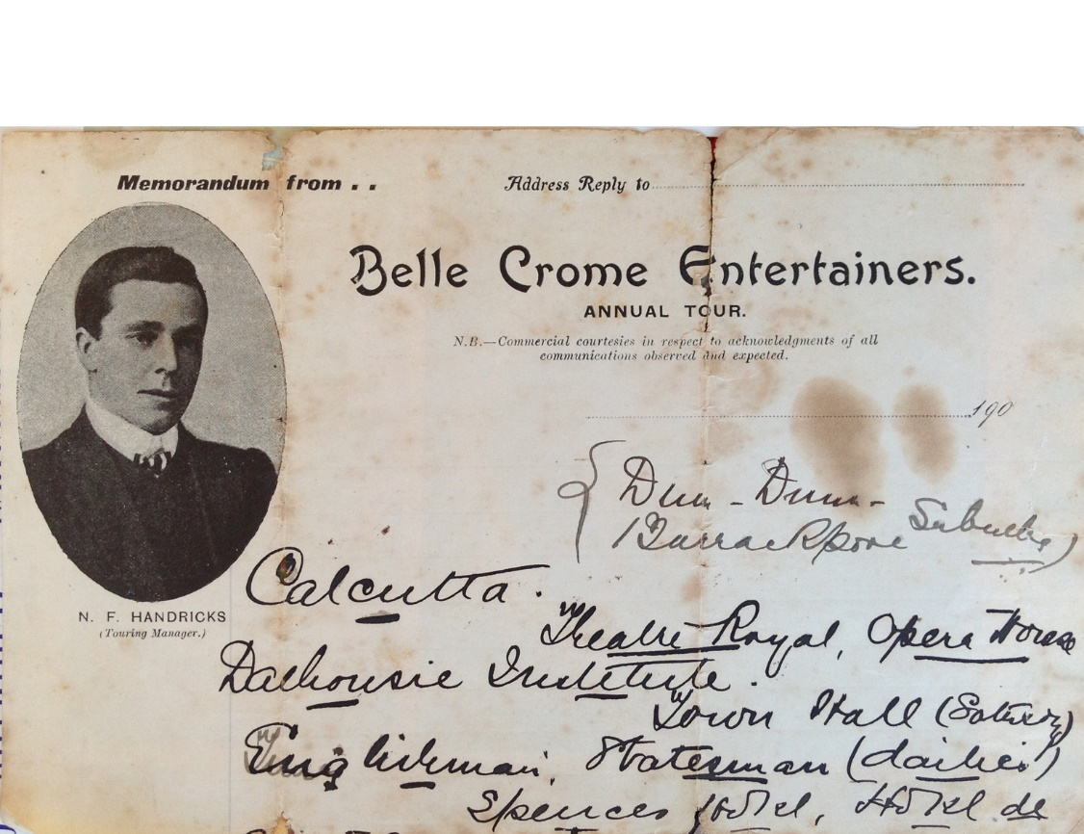
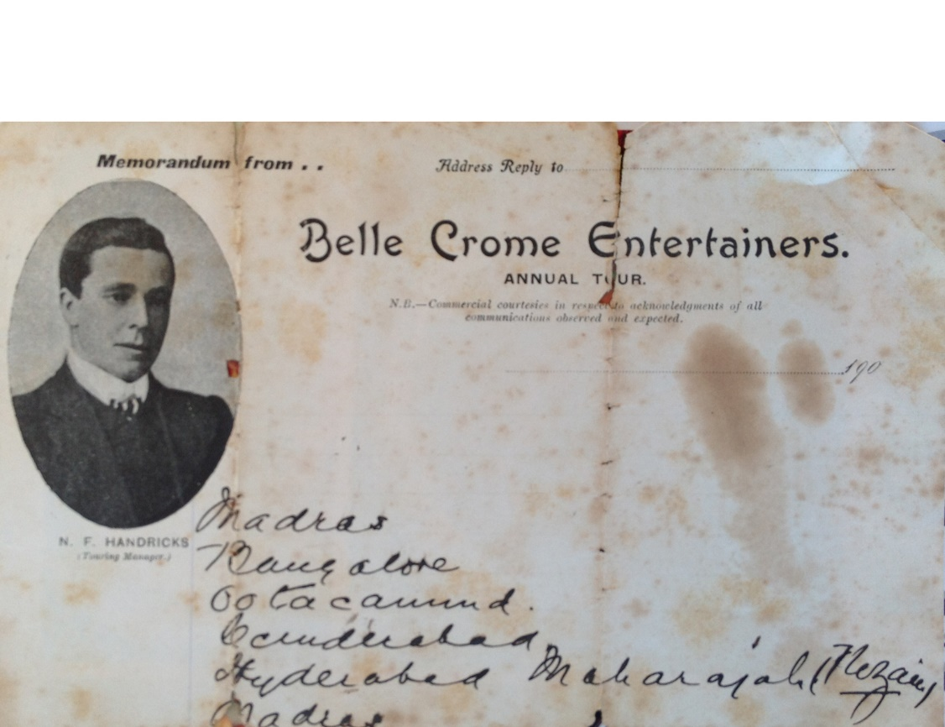
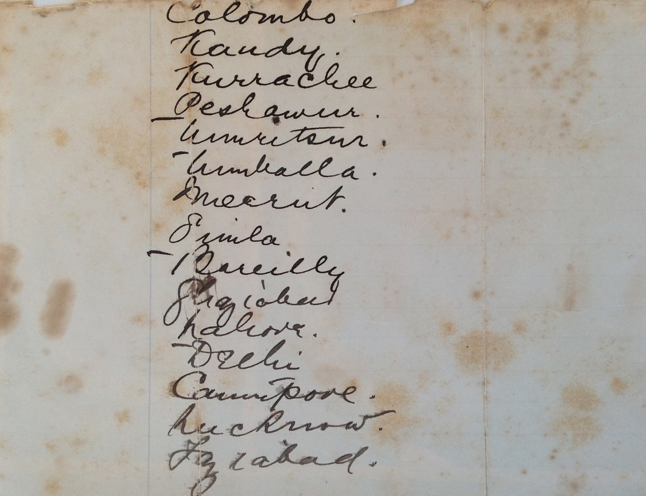
… Madras, Hyderabad, Bangalore …
Norrie toured shows around the world – Calcutta, Capetown …
…Colombo, Delhi,
London,
Paris,
Berlin,
Lucknow …

Slide 30
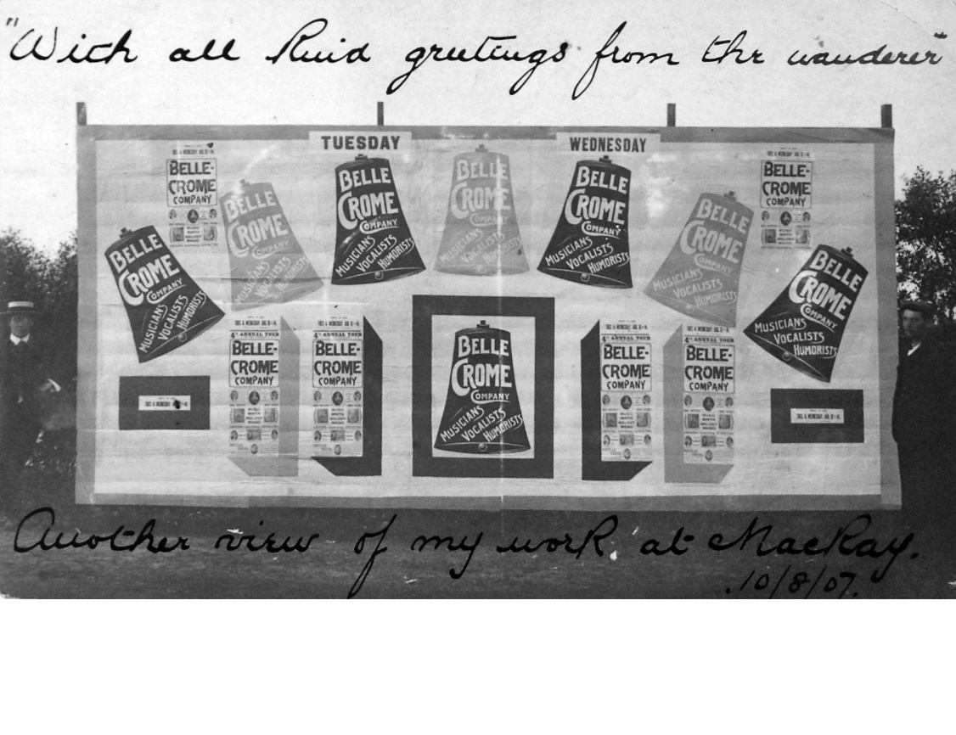
He was a master showman – did his own poster work

Slide 31
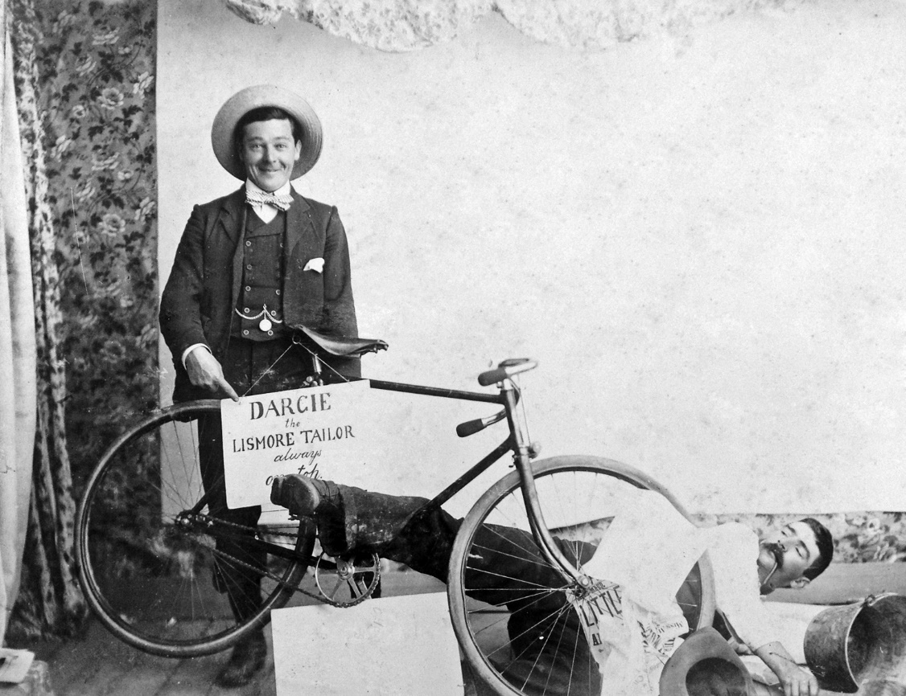
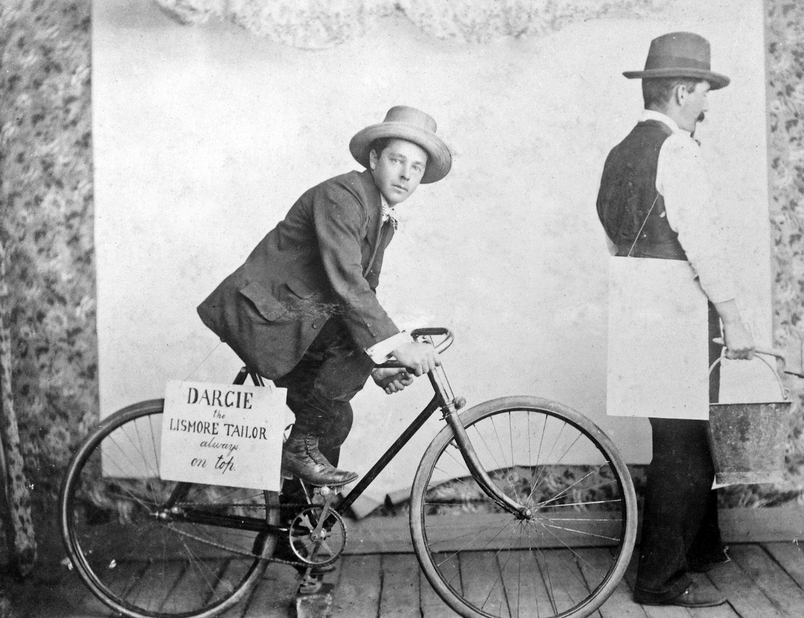

Slide 32
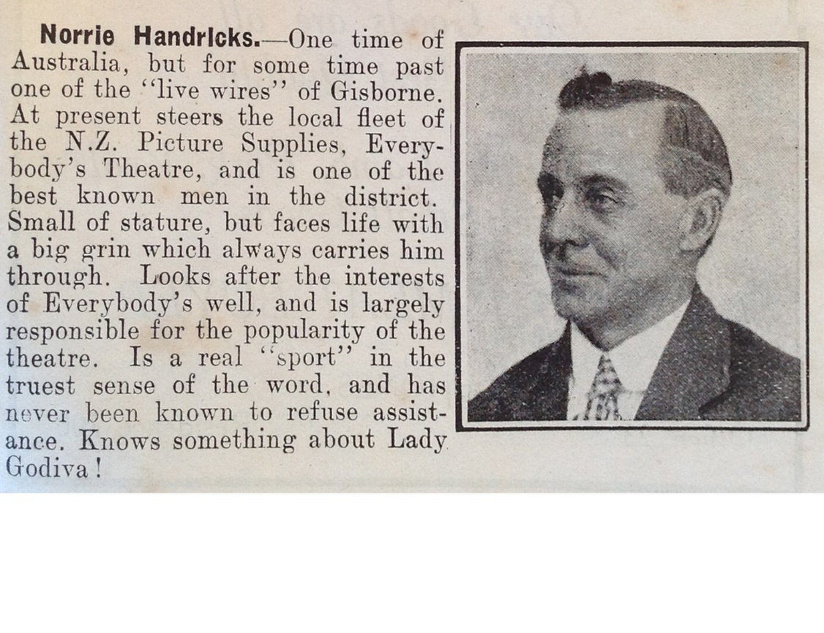
From the “1929 Almanac of New Zealand”

Slide 33
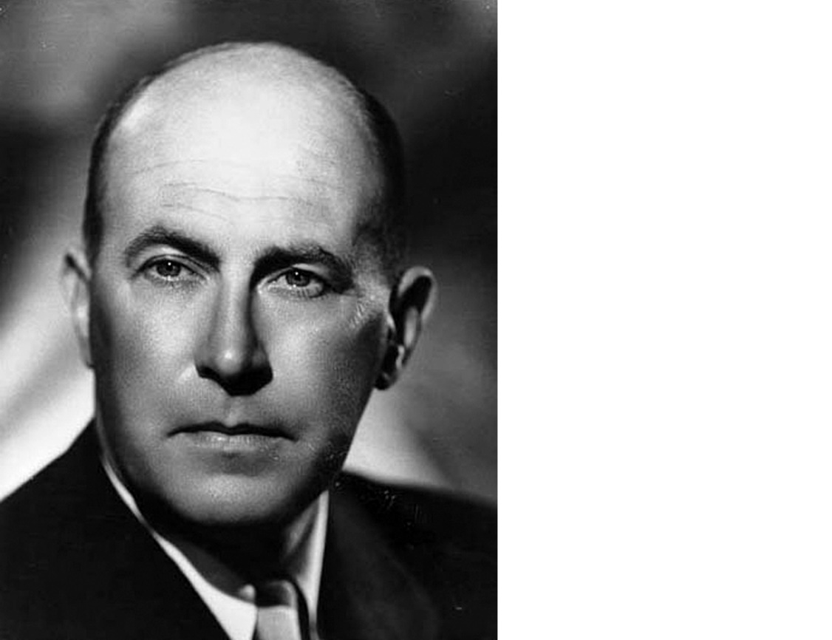
In 1916, my grandfather, Norrie, employed a young lad to be a “gopher” for the theatre … his name was Robert Kerridge … later to become Sir Robert Kerridge, the owner of His Majesty’s Theatre

Slide 34
… now back to the story of
His Majesty’s Theatre

Slide 35
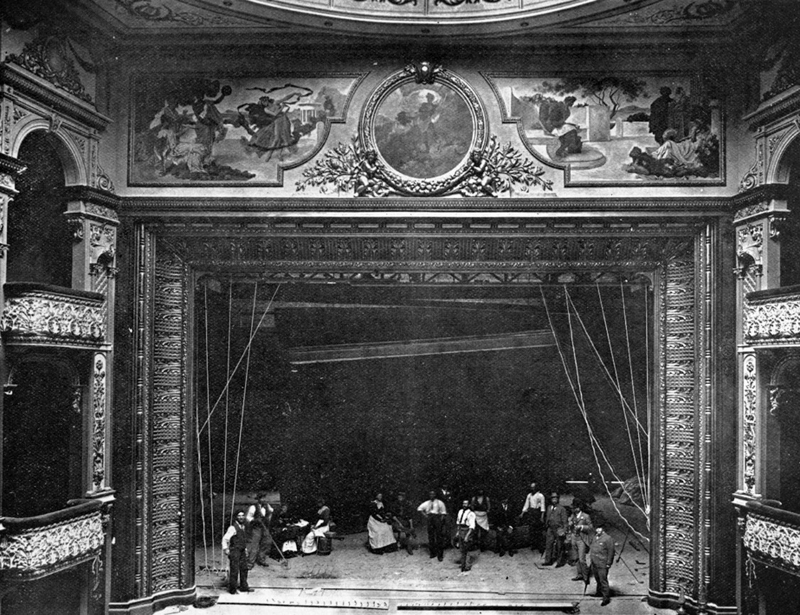
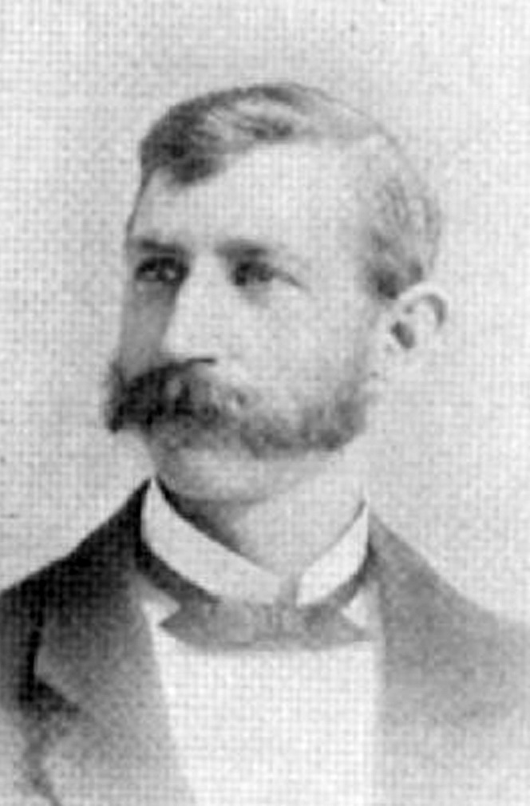
In 1903 Charles Rauger Bailey became the manager of the theatre

Slide 36
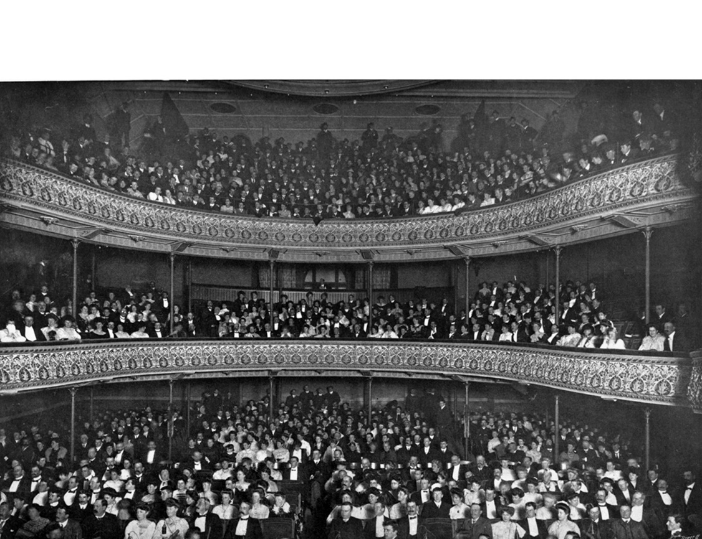
His Majesty’s became a major venue throughout the next seventy years

Slide 37
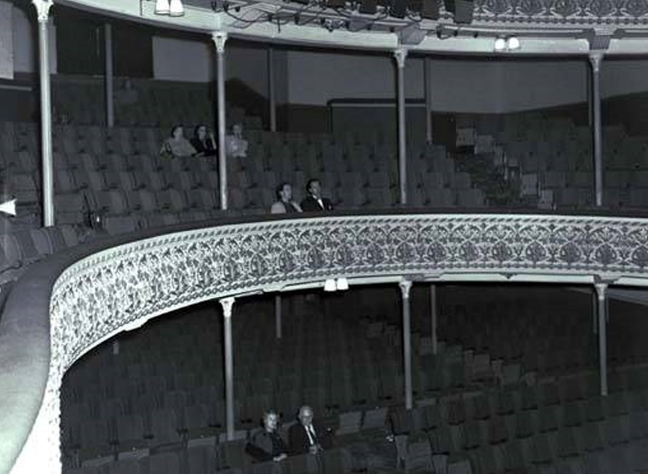
Seating was comfortable … but oh, those poles!

Slide 38
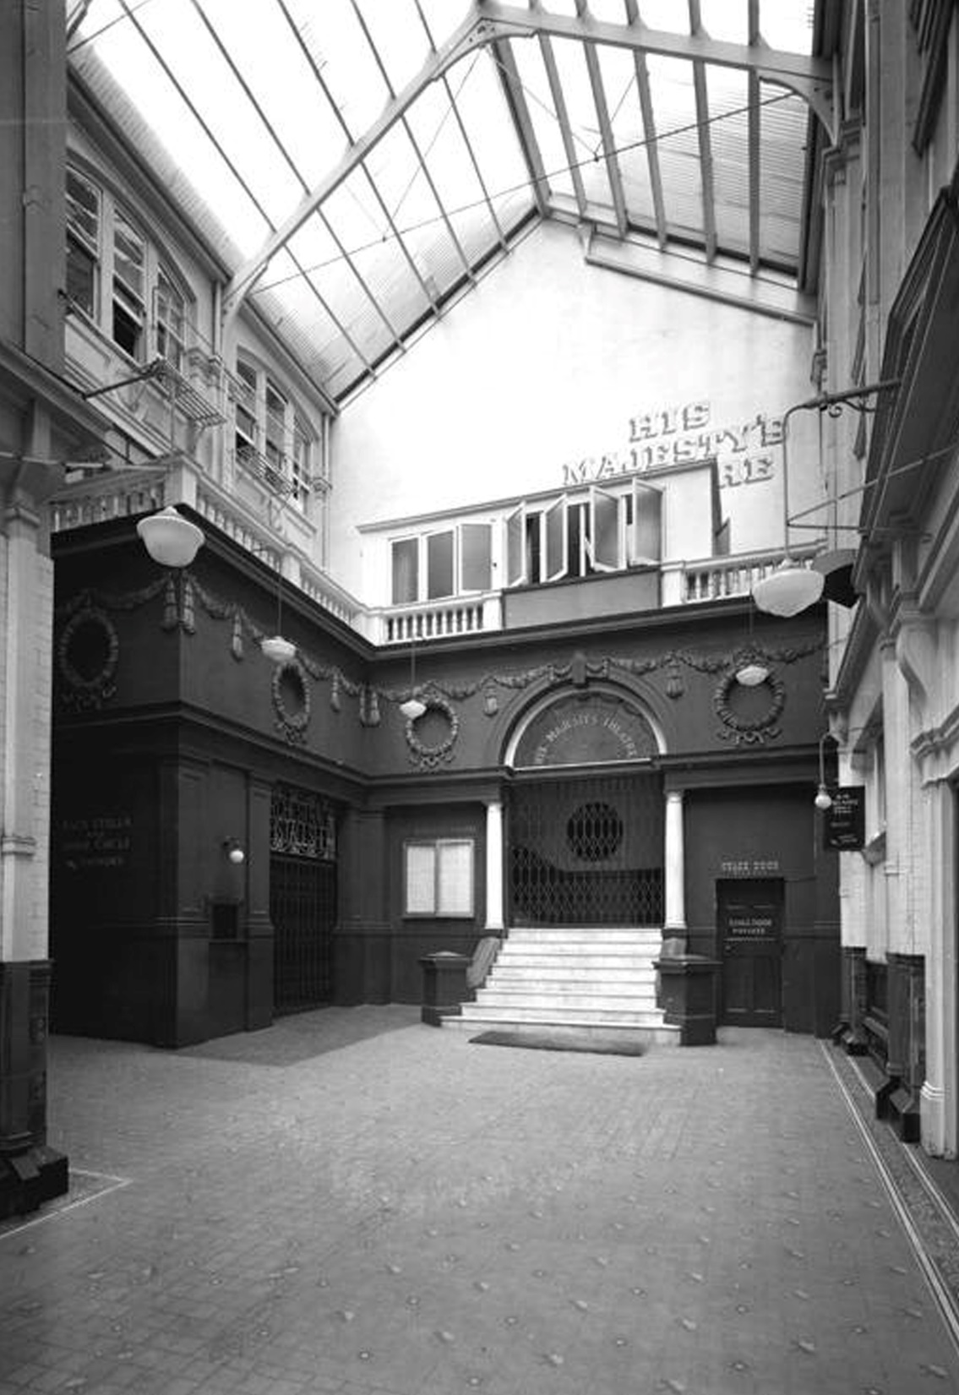
The arcade had a Nibble Nook to the right of the stage door, a flight of stairs to the dress circle (between the “marble” pillars)
The managers apartment was above that, access to the stalls to the left and you had to go into Durham Lane to climb all the way to the “Gods”
There was a massive DC generator under the theatre.

Slide 39
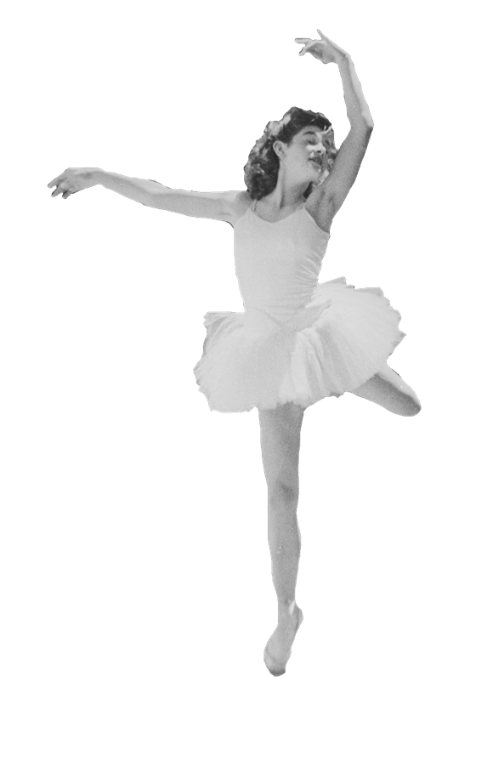
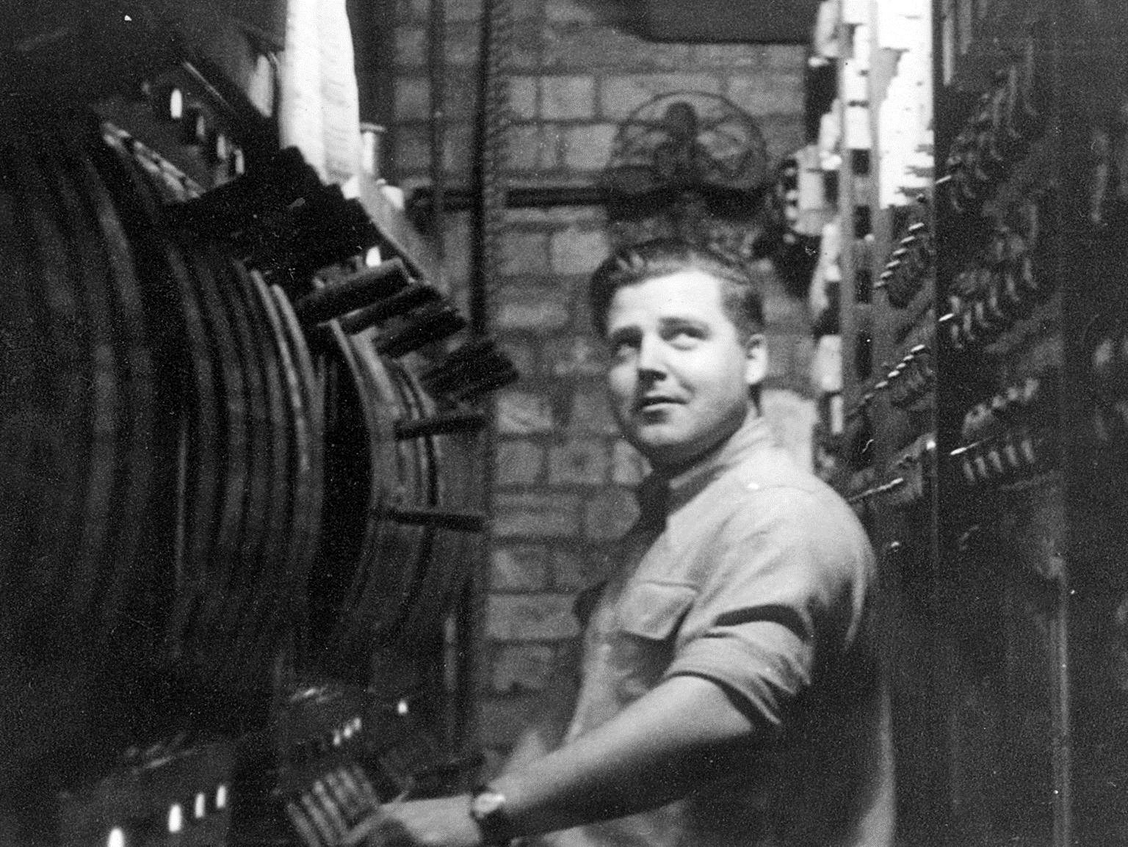
It was here where he met my mother – a dancer
My father was the theatre’s electrician

Slide 40
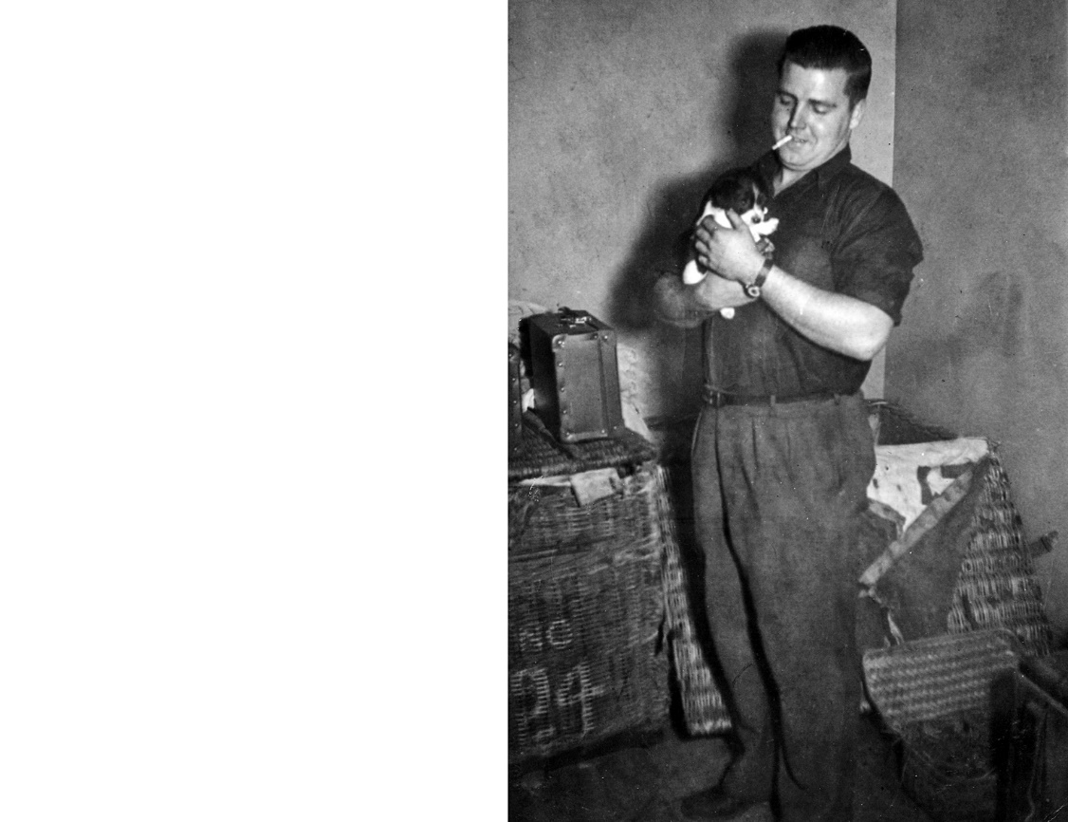
Costumes and props in the theatre world are stored in skips – held in the “Green Room”
Theatre is full of strange rituals and superstition …

Slide 41
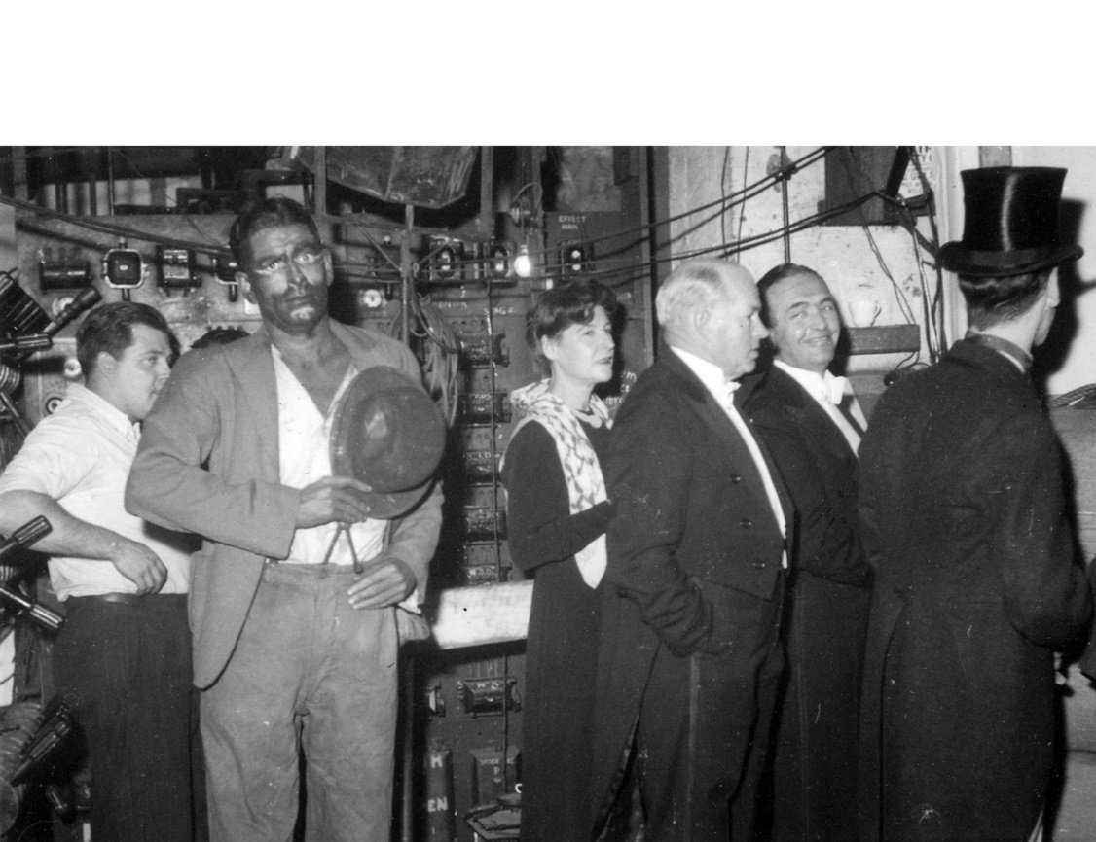
The “Green Room” is never painted green

Slide 42
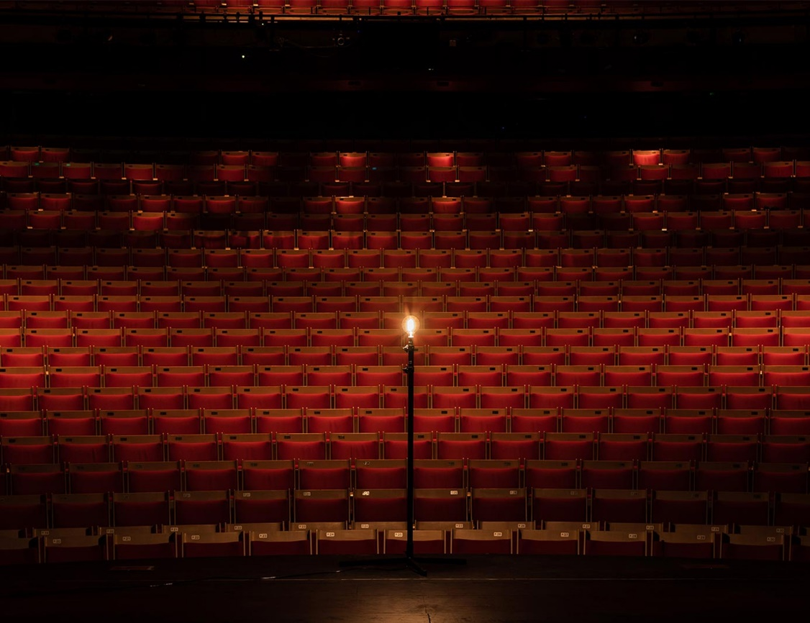
The ghost light
At the end of the evening, the last person in the theatre must leave a light bulb on a post, called a ghost light, lit in the middle of the stage. This light appeases the ghosts living in the theatre and gives them light to perform during the evening.

Slide 43
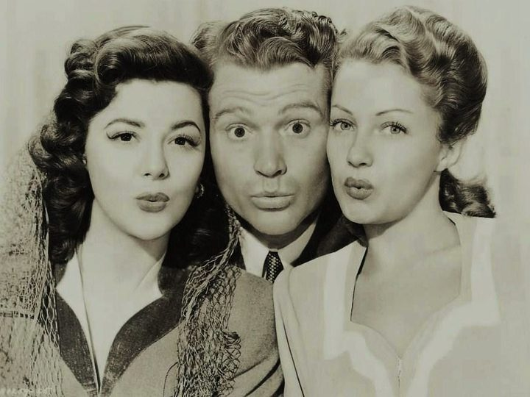
You cannot whistle backstage

Slide 44
Whistling in the theatre is considered bad luck. This superstition started in the middle of the 1600s when theatrical scenery began to fly.
Sailors had extensive knowledge of ropes, rigging and knots and were hired backstage as run crew.
Like on a ship, the sailors would communicate with each other through whistles to bring a backdrop in or out.
Consequently, a whistling actor onstage could start a scene change early or get knocked out from incoming scenery.

Slide 45
Don’t quote MacBeth backstage
Most actors will only refer to the famous tragedy as “The Scottish Play,” believing that Shakespeare gave his three witch characters in the opening scene real spell incarnations for lines. As retaliation, a coven of actual witches cursed the play. It’s said that the actor playing Lady Macbeth tragically died on opening night in 1606 and Shakespeare himself had to step in.

Slide 46
You may not leave soap in a hand basin

Slide 47
Out the stage door … then turn around three times and beg to be let in

Slide 48
Some Terminology in Theatre:
Limelight Mechanist Stage Manager
Rake Batten French Brace
Prompt OP Drops
Pit Carbon Arcs Blocks & Cradles
Proscenium Cloth Cues
Fly Floor Medium
Dimmer Flats
Legs Pancake
5 and 9 Wings
Barn Doors

Slide 49
My mother was a dancer …

Slide 50
…she danced for more than 70 years and danced with many famous people including Nureyev

Slide 51
My parents met during a show called “The Girlfriend” …
Married during a show called “The Boyfriend” …
And separated for good during a show called “The Merry Widow”

Slide 53
Mum continued performing professionally well into her seventies
In her lifetime she appeared on stage in more than 5000 performances

Slide 54
A favourite haunt of show people was the “White Lady” pie cart

Slide 55
At just 9 years old I started working at His Majesty’s Theatre
Moving spotlights on stage and general duties with props
I continued working there for the next 23 years in virtually every performance
at the theatre

Slide 56
My only time in front of the audience was in the 1965 Gang Show … I played the part of a pussy cat!

Slide 57
I completed the last ever apprenticeship offered in theatre craft learning and doing most roles backstage – lighting, scenery, props, stage management, mechanist, follow-spot operator and flyman!

Slide 58
The flyman’s job is tough and back-breaking work
Like sailors on a sailing ship, the flyman is handling ropes, weights and counter-weights mostly in black-out conditions at breakneck speed

Slide 60
The old His Majesty’s Arcade and Theatre Company was taken over at some point by J C Williamson & Son who put the theatre and arcade on the market in 1976

Slide 61
The was insufficient income to meet costs and the Auckland City Council responded at the time by setting up a special sub-committee to look into purchasing the site

Slide 62
but the $1.25 million asking price was too steep. The Council at the time advised they were powerless to prevent demolition by applying a special designation to the building, due to the “reasonable development” clause of the then-governing act.

Slide 63
The council considered the building to be of significant heritage value, and by then the Historic Places Trust had given it a category 2 on its register. Eventually, Auckland City Council gave the theatre-arcade complex a B on their schedule – but the owners appealed in 1977, and it was reduced to the lower level of protection of C

Slide 64
Williamsons finally sold their property
to Kerridge Odeon Corporation
Demolition of the building now became imperative

Slide 65
Demolition work began on the night of 23-24 December 1987. Protestors gathered, and the Council inspector was summoned, gaining entry at 1am to tell the workmen inside to cease, as the demolition permit, applied for by Pacer Corporation, had only been lodged the day before.

Slide 66
The permit was granted anyway on 31 December 1987, and the demolition proceeded

Slide 73
My mother was heartbroken at the loss of the theatre
I rescued a brick from the demolition site and buried it with my mother when she passed away.

Slide 74
R.I.P.
His Majesty’s Theatre & Arcade
(1902-1987)

